Slide 2
Free Grace Alliance National Conference 2016
Arlington, Texas

Slide 3
Romans 11:6 But if it is by grace, it is no longer on the basis of works, otherwise grace is no longer grace.
Romans 4:16 For this reason it (the unconditional promise to Abraham) is by faith, in order that it may be in accordance with grace, so that the promise will be guaranteed to all the descendants, not only to those who are of the Law, but also to those who are of the faith of Abraham, who is the father of us all

Slide 4
The word grace in NT Greek is CHARIS
It is found about 160 times in the NT
It is an important word and even more important concept
I would venture to say the most important functioning concept in the Christian's salvation and Spiritual life

Slide 5
All that God is free to do for us as a result of Christ‘s deaths upon the Cross
God's Riches At Christ's Expense
It is free to recipient but it is not Cheap Grace (Bonhoeffer and Powell). Grace cost God the highest price which was the death of His Son
Grace is the unmerited favor of God toward men
It is a gift from God and therefore cannot be earned or deserved, worked for or based on merit

Slide 6
Ten Truths of the Free Grace Message:
FG teaches that salvation is absolutely free
Salvation can be received only through faith
The object of faith is the Lord Jesus Christ.
FG teaches the finished work of Christ.
FG is the only basis for assurance of salvation
FG distinguishes between salvation and discipleship
The Christian life is also by grace through faith
FG is the best environment for Christian growth
In Free Grace the Christian is accountable
FG is committed to accurate interpretation of the Bible

Slide 7
Problems with Grace in the Third-World Church:
Improper post salvation teaching by missionaries
Lack of proper training for pastors
Pastors who want to control congregations
Law is easier to teach than grace
Law is equated with religion more than grace
Paying for blessing and prayers (gifts) within the church
The Prosperity Gospel

Slide 8
Problems with Grace in Third-World Society:
Paying for what should be free
Police protection
Admission to schools
Driver' License
Getting through customs
Meeting with government officials
Corruption, the bribe (Do you have something for me?)
If you want something done, money must be paid
Government jobs
Meeting with a government committee
Building permits or permits of any kind
Getting out of a violation of law (even up to murder)
Paying for Ebola medication provided free by other governments
Politicians embezzling money

Slide 9
Problems with Grace with Fallen Man
1. There is no such thing as a free _____________
Man thinks that with anything FREE there must be a catch
Or if it is FREE it is of no value

Slide 10
Few quotes on our attitude towards the FREE
Christopher S. Penn: There is no such thing as free unless the thing in question is without value.
Mike Lipkin: I would do this (his paid subscription Economic blog) for free but I make you pay so that you understand the value of what you are getting.
Theodore Roosevelt: Nothing in the world is worth having or worth doing unless it means effort, pain, difficulty…
But then there is this from the movie True Grit, Mattie Ross: You must pay for everything in this world, one way and another. There is nothing free except the grace of God.

Slide 11
Problems with Grace with Fallen Man (Continued)
2. The Old Testament Law (Law of Moses)
Deuteronomy 11:26-28 See, I am setting before you today a blessing and a curse . . .
Joshua 8:34 Then afterward he read all the words of the law, the blessing and the curse, according to all that is written in the book of the law.

Slide 12
Jesus came to fulfill the Law and in doing so we are no longer under Law but under Grace:
Romans 6:14 For sin shall not be master over you, for you are not under law but under grace.
Galatians 2:21 I do not nullify the grace of God, for if righteousness comes through the Law, then Christ died needlessly.
John 1:17 For the Law was given through Moses; grace and truth were realized through Jesus Christ.
Matthew 5:17 Do not think that I came to abolish the Law or the Prophets; I did not come to abolish but to fulfill.
Galatians 3:13 Christ redeemed us from the curse of the Law, having become a curse for us--for it is written, cursed is everyone who hangs on a tree.

Slide 13
The Law was given as a divine constitution for a nation and it was a law of cursing and blessing for a nation. And it applied to believers, unbelievers, foreigners sojourning in the land.
The Old Testament Law was given to a nation, Israel. Believers and unbeliever and even foreigners in the Land:
In over 200 verses in the giving of the ML God told Moses that the law is for the sons (plural) of Israel.
The Law was given as a divine constitution for a nation and it was a law of cursing and blessing for a nation. And it applied to believers, unbelievers, foreigners sojourning in the land.
When it came to God dealing with individuals it was always in GRACE

Slide 14
Man’s Basic Instinct
Jude 1:10 But these men revile the things which they do not understand; and the things which they know by instinct, like unreasoning animals, by these things they are destroyed.
Colossians 2:8 See to it that no one takes you captive through philosophy and empty deception, according to the tradition of men, according to the elementary principles of the world, rather than according to Christ.
Colossians 2:2-21 If you have died with Christ to the elementary principles of the world, why, as if you were living in the world, do you submit yourself to decrees, such as, Do not handle, do not taste, do not touch

Slide 15
Romans 2:14-15
For when Gentiles who do not have the Law do instinctively the things of the Law, these, not having the Law, are a law to themselves, in that they show the work of the Law written in their hearts, their conscience bearing witness and their thoughts alternately accusing or else defending them.

Slide 17
So both by nature (the curse) and by nurture (tree of the knowledge of good and evil) man is locked into a works mentality that must be broken to live in the grace plan of God.
The flesh seeks validation of itself. We love the commendation of man regarding what we accomplish and perform.

Slide 18
NEXT: The Problem of our Current Theology
1730s and 40s: The First Great Awakening, Jonathan Edwards and George Whitefield , emphasis on the greatness of God and His Grace.
1840s and 50s: The Second Great Awaking, Charles Finney, Shift from what God has done to provide salvation to what man must do to gain salvation.

Slide 19
B. B. Warfield (1851-1921) on Finney's Teaching Wrote
. . . it is not theology at all. This is ethic in which God might be eliminated entirely from Finney's theory without injury to it.

Slide 20
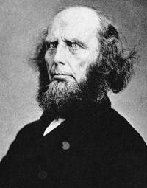
Charles Finney 1792-1875
Regeneration consists in the sinner changing his ultimate choice, intention, and preference; or in changing from selfishness to love and benevolence; or, in other words, in turning from the supreme choice of self-gratification, to the supreme love of God and the equal love of his neighbor. Of course the subject of regeneration must be an agent in the work

Slide 21
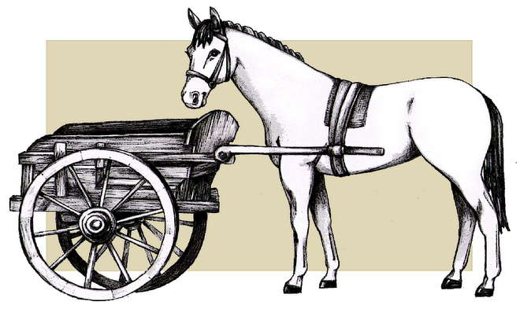
Obedience before Faith, Law before Spirit, Works to gain Grace . . . All putting the Cart before the Horse

Slide 22
Good Hermeneutics Includes:
Observation
Interpretation
Application
Today Interpretation is being left out of the porcess

Slide 23
Adding to grace, either before or after faith, nullifies grace
Galatians 5:4 You have been severed from Christ, you who are seeking to be justified by law; you have fallen from grace.

Slide 24
So What is the Solution to the Rejection of Grace?
Be aware that there is a problem
Be aware of our inherit nature that is opposed to grace: Conditioning - Pride - Insecurity
Recognize that Grace distinguishes God’s plan from all other religions
See Grace in every part of the Word of God
Study the Word with the eyes of Grace

Slide 25
Mark 4:24-25 And He (Jesus) was saying to them, Take care what you listen to. By your standard of measure (Grace or Law, Works or Faith) it will be measured to you; and more will be given you besides. For whoever has, to him more shall be given; and whoever does not have, even what he has shall be taken away from him.

Slide 26
So What is the Solution to the Rejection of Grace?
Be aware that there is a problem
Be aware of our inherit nature that is opposed to grace: Conditioning - Pride - Insecurity
Recognize that Grace distinguishes God’s plan from all other religions
See Grace in every part of the Word of God
Study the Word with the eyes of Grace
Humility: Living in grace keeps us humble which allows us to experience more grace
James 4:6 But He gives a greater grace. Therefore . . . God is opposed to the proud, but gives grace to the humble.

Slide 27
WHY WOULD WE EVER TURN AWAY FROM THE GRACE OF GOD?
Copyright © 2016 Grace Gospel Missions

