Slide 1
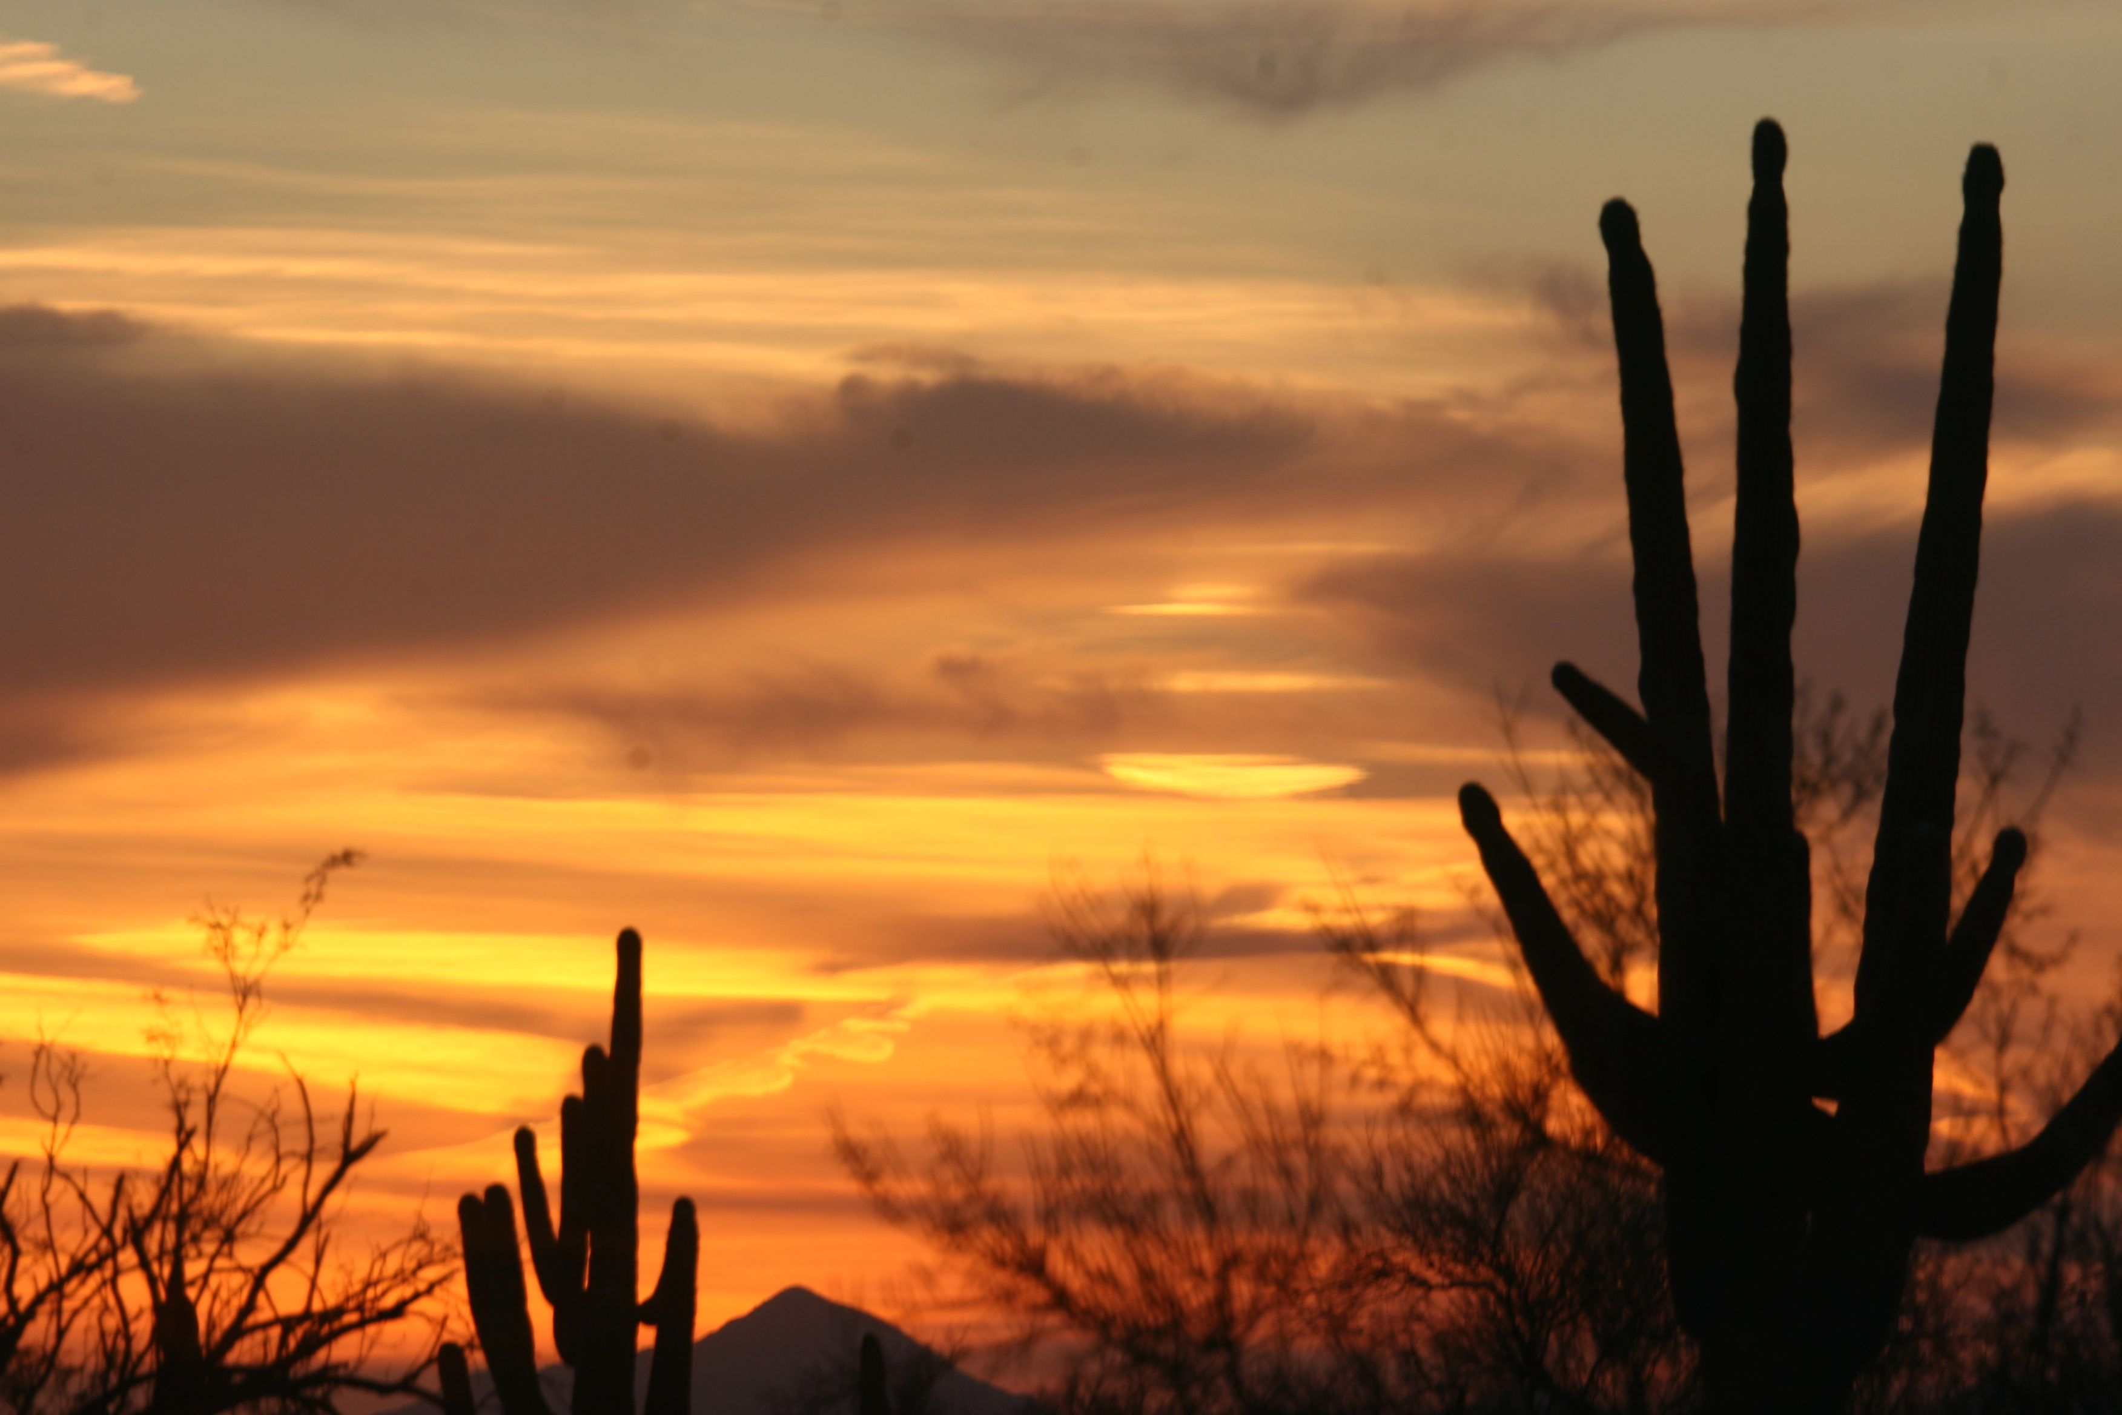
Tucson Bible Church

Slide 2
Fear the Fork
Tucson Bible Church

Slide 3
Tucson Bible Church

Slide 4
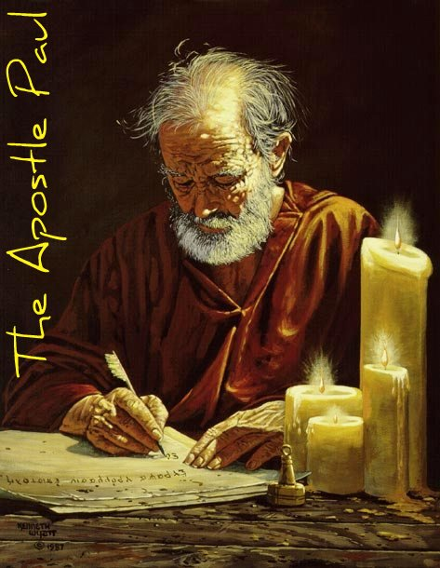
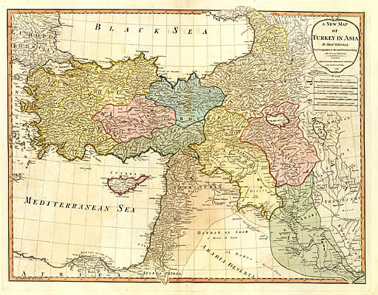
Paul’s Epistle to the Galatians

Slide 5
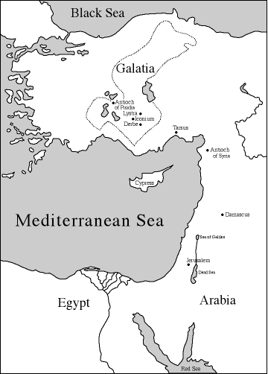

Slide 6
PAUL in the G.N.T. παλους, this was Paul's Gentile name. Not a special Christian name.
He was a Jew of Tarsus born to Jewish parents who were also Roman Citizens. Thus, he had both a Hebrew and Roman name:
HEBREW NAME: Saul ben (son of) (Dad's name, John??)
GENTILE NAME: Paul Saul Benjamin (His tribe)
Saul means asked for one while the name Paul means little or insignificant.

Slide 7
THE DIVINE FORMULA OF PEACE:
1st Grace from God, utilizing all the grace that we have in the C.W.L.
2nd Peace under three categories:
Romans 5:1 Peace with God in Reconciliation
Galatians 1:3 Peace that comes from God
Philippians 4:7-8 Sharing the very peace of God

Slide 8
As the Gospel is Faith + nothing, the Spiritual Life is also faith + nothing.
We live a life of faith . . . no merit in faith only merit in the object of that faith:
At Salvation: Object is the Lord Jesus Christ
In the C.W.L.: Object is the Holy Spirit and the Word of God

Slide 9
Jude 1:4
For there are certain men crept in unawares, who were before of old ordained to this condemnation, ungodly men, turning the grace of our God into lasciviousness, and denying the only Lord God, and our Lord Jesus Christ.

Slide 10
Revelation 22:18-19
For I testify unto every man that hears the words of the prophecy of this book, If any man shall add unto these things, God shall add unto him the plagues that are written in this book.
And if any man shall take away from the words of the book of this prophecy, God shall take away his part out of the book of life, and out of the holy city, and from the things which are written in this book.

