Slide 2
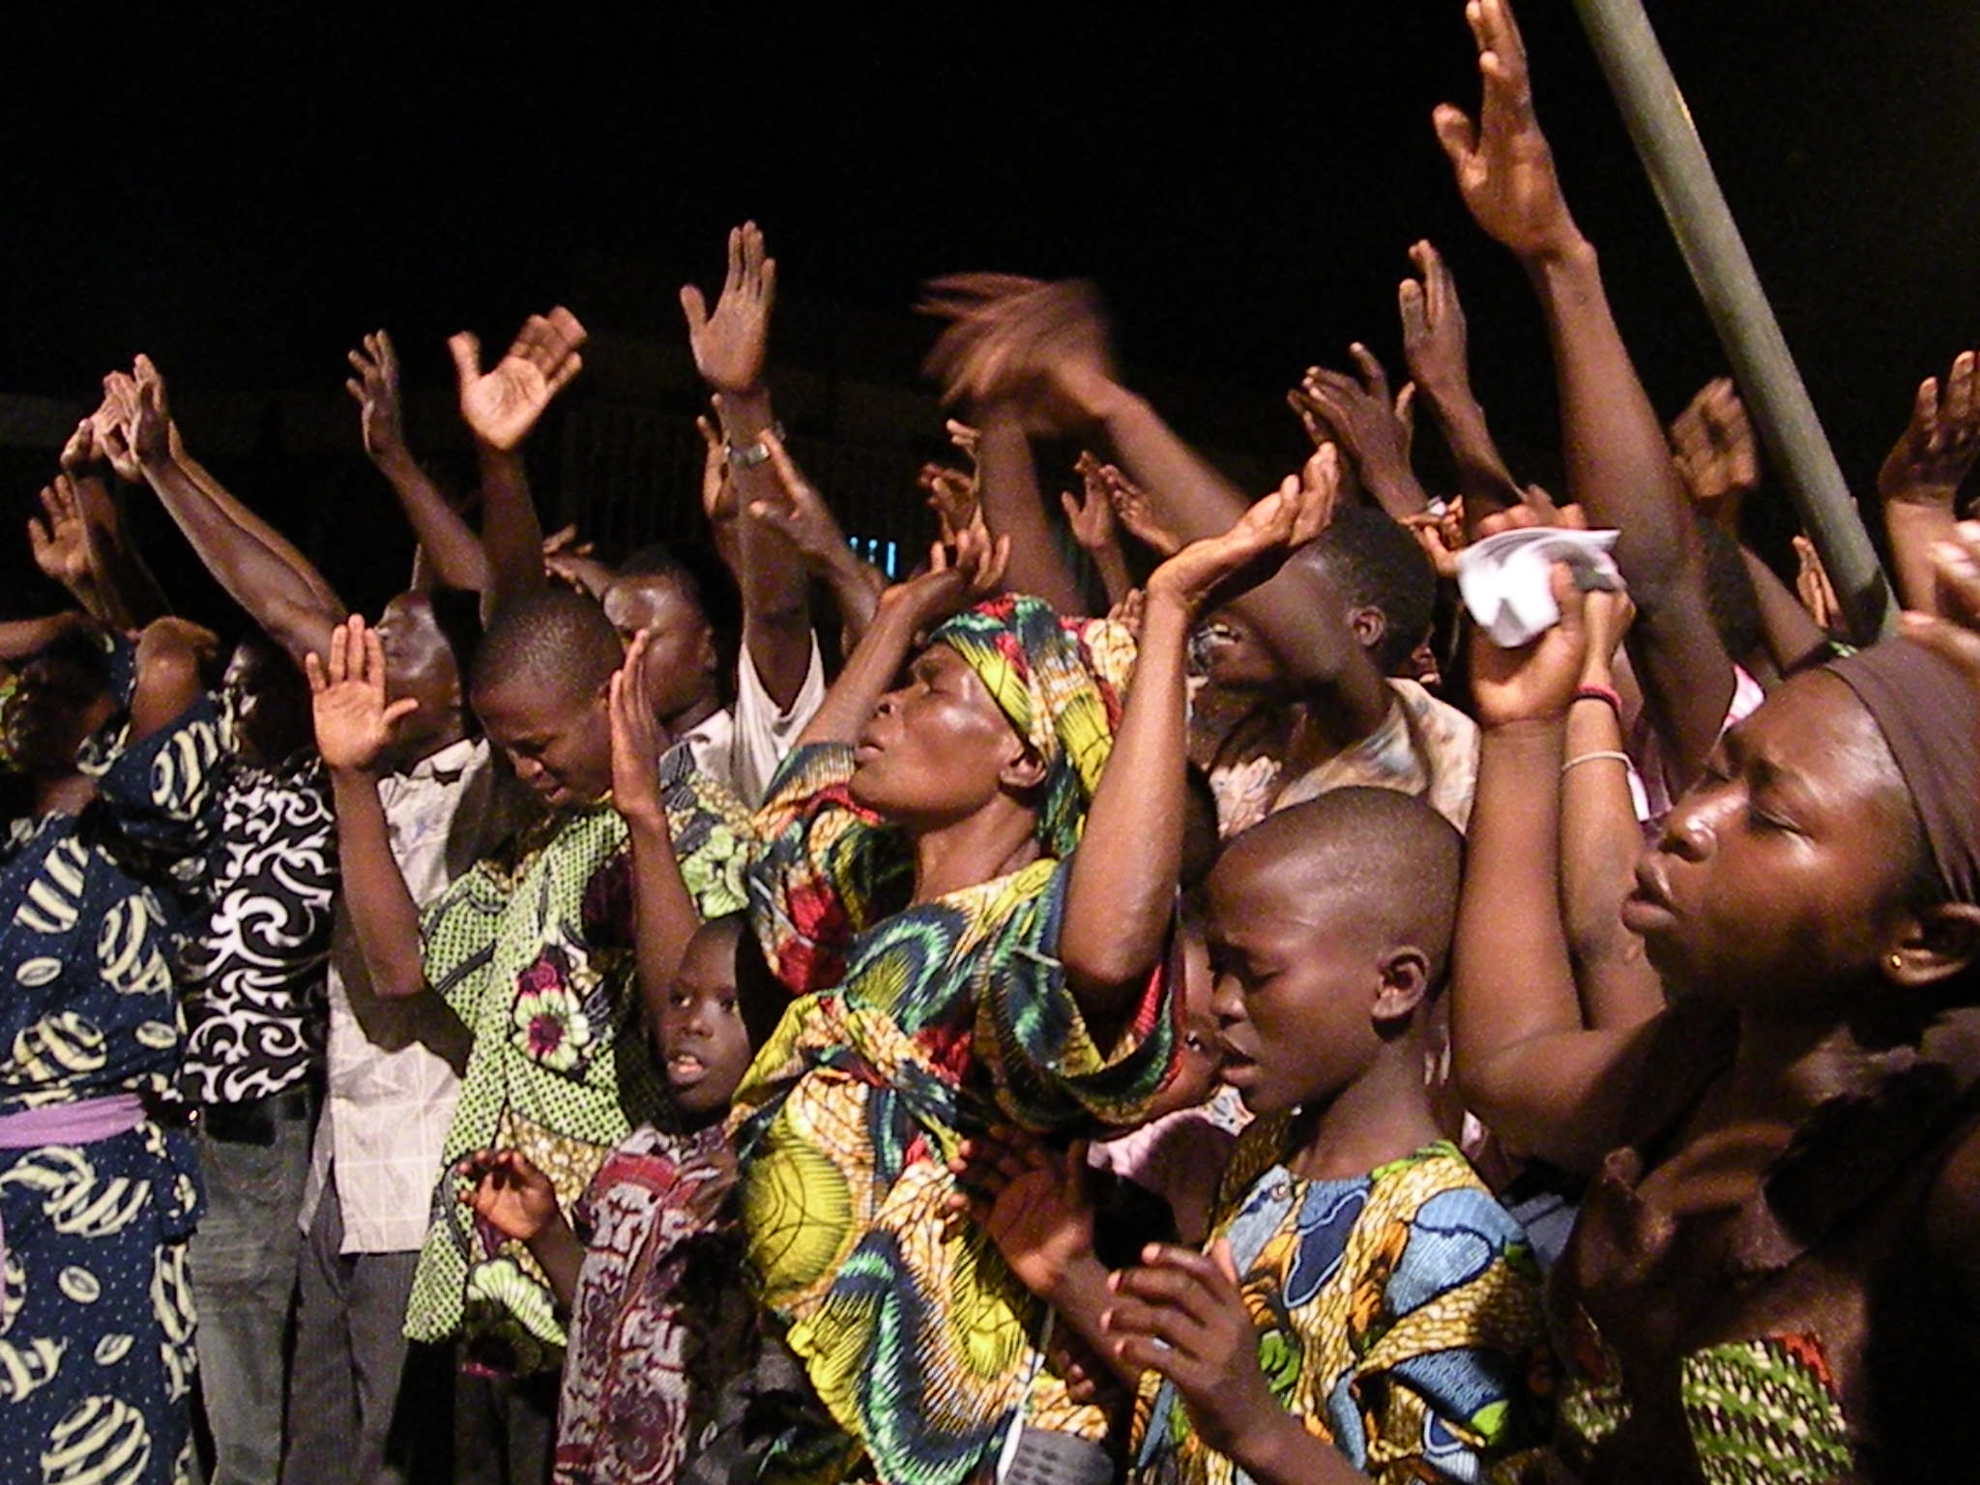
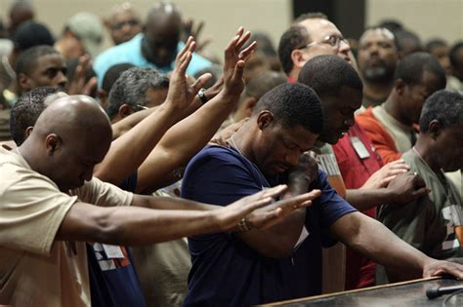
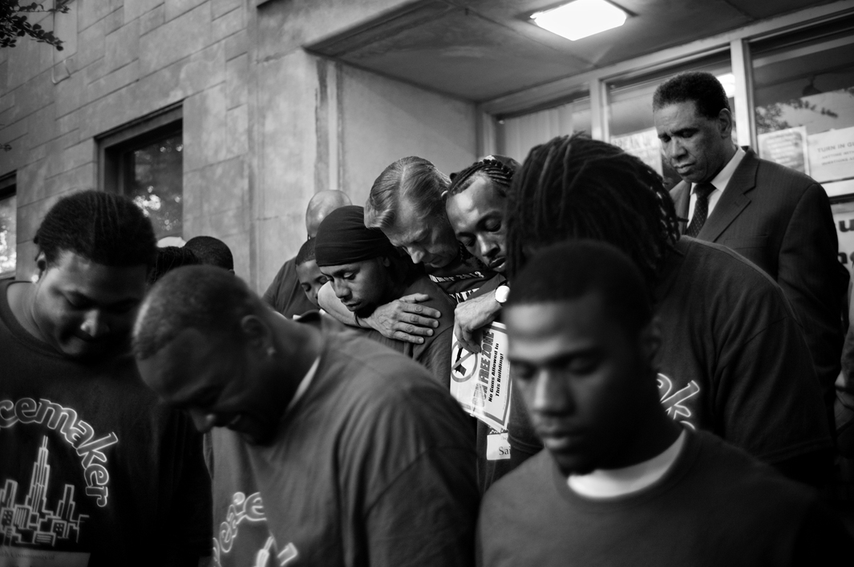
The Theology of Worship
Ambassador International University
April 2019
Instructor: Daniel W. Hill, Ph.D.

Slide 3
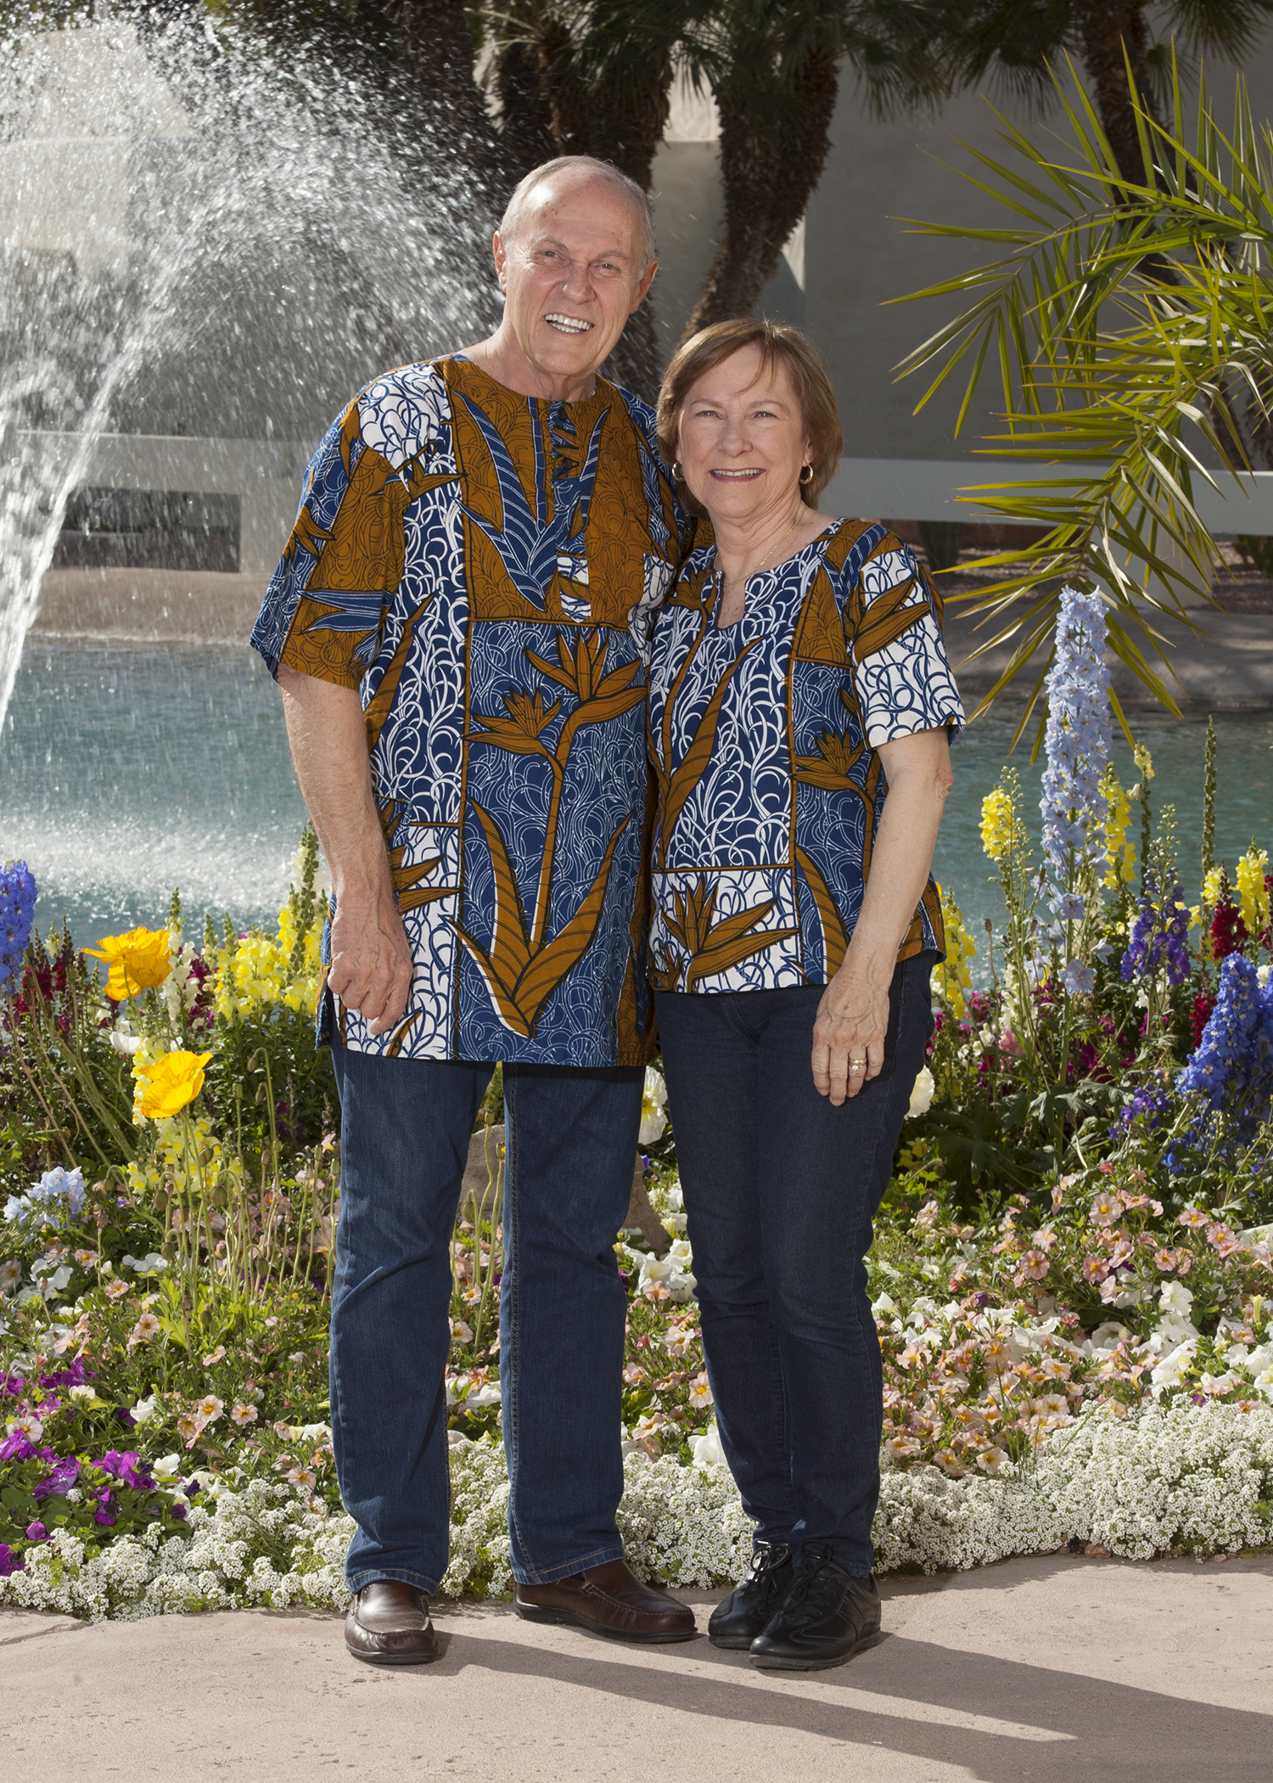
Dr. Dan and Mrs. Pat Hill
Tucson, Arizona USA

Slide 4
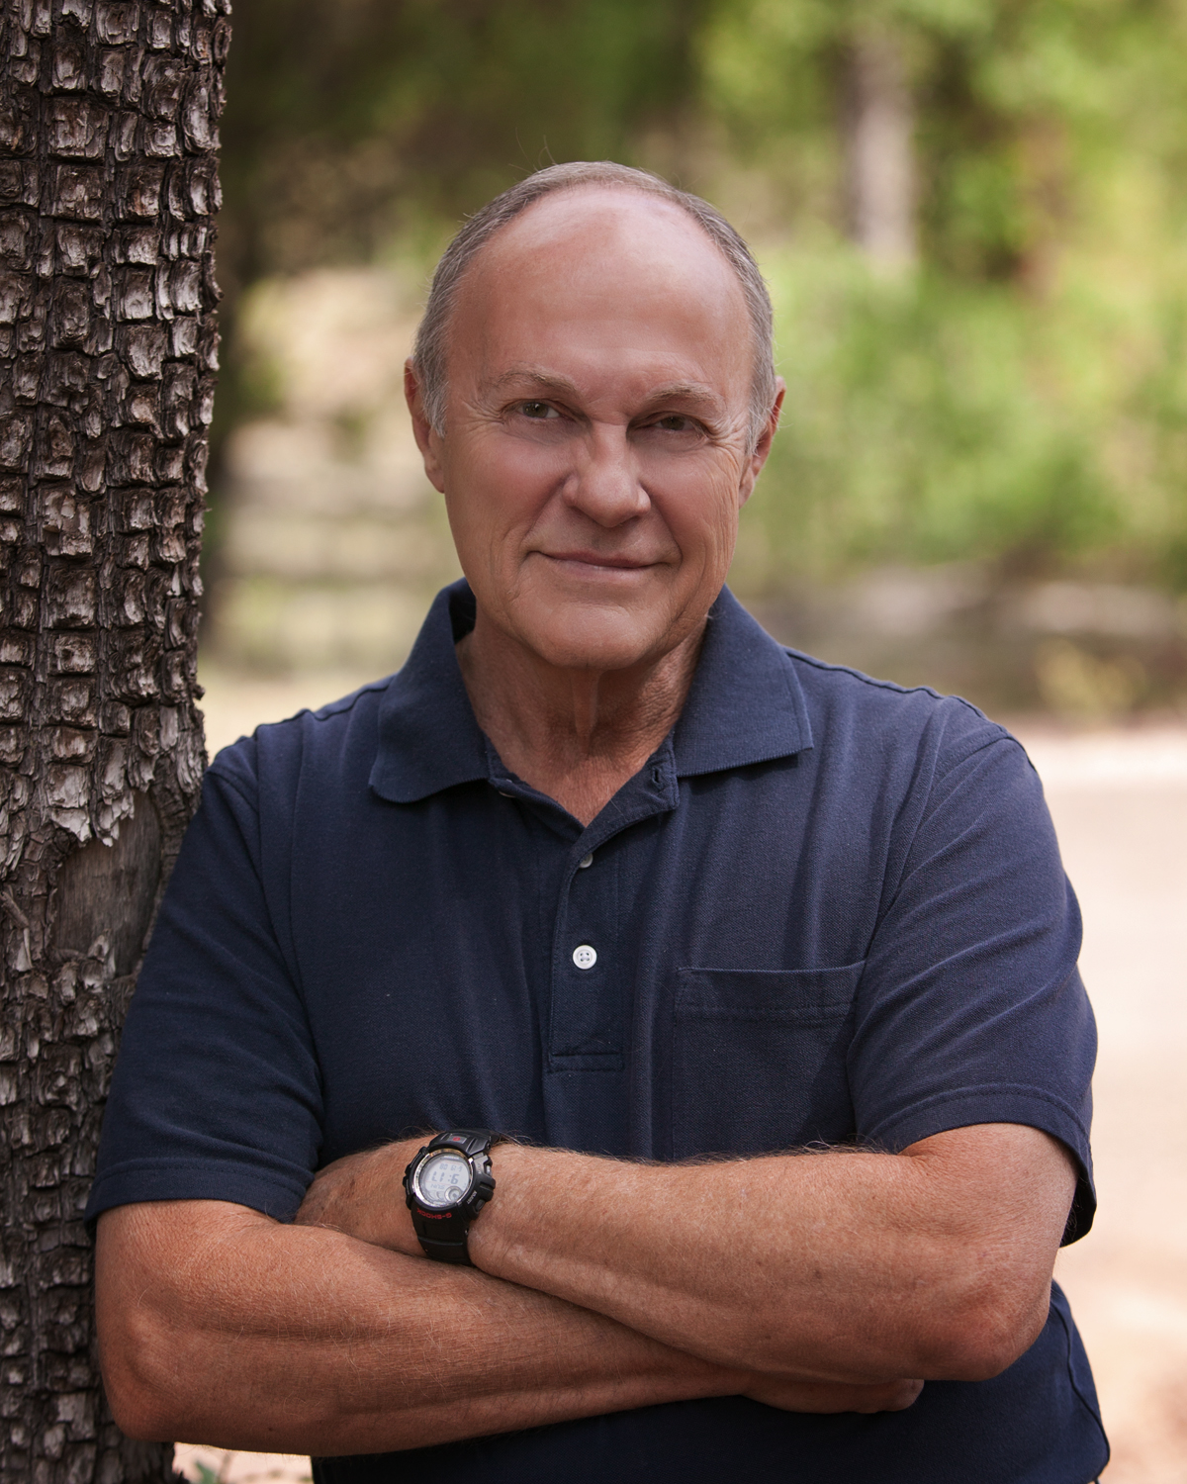
Served in the US Military: US Navy
Became a Christian at age 20
Graduated from Arizona State University
Taught in the Public Schools
Masters from Dallas Theological Seminary
Ph.D. from California Graduate School of Theology
Pastored for 35+ years in the US, 20 of those years at Southwood Bible Church in Tulsa, Oklahoma USA
Moved to Liberia in 2010 with Pat and served as a missionary with SIM for five years
Has written for Alpha Omega Publications, Grace Notes (online) and has three books published by Amazon

Slide 5
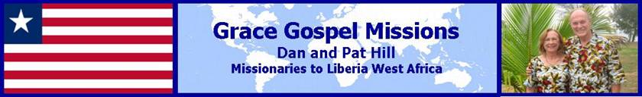
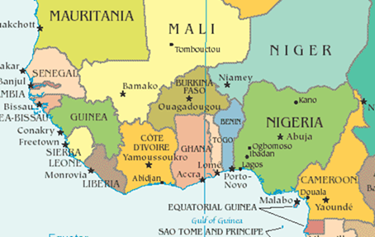


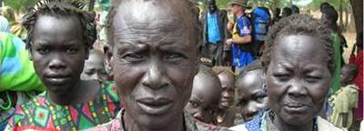

2010 to 2015
SIM Serving in Missions

Slide 6

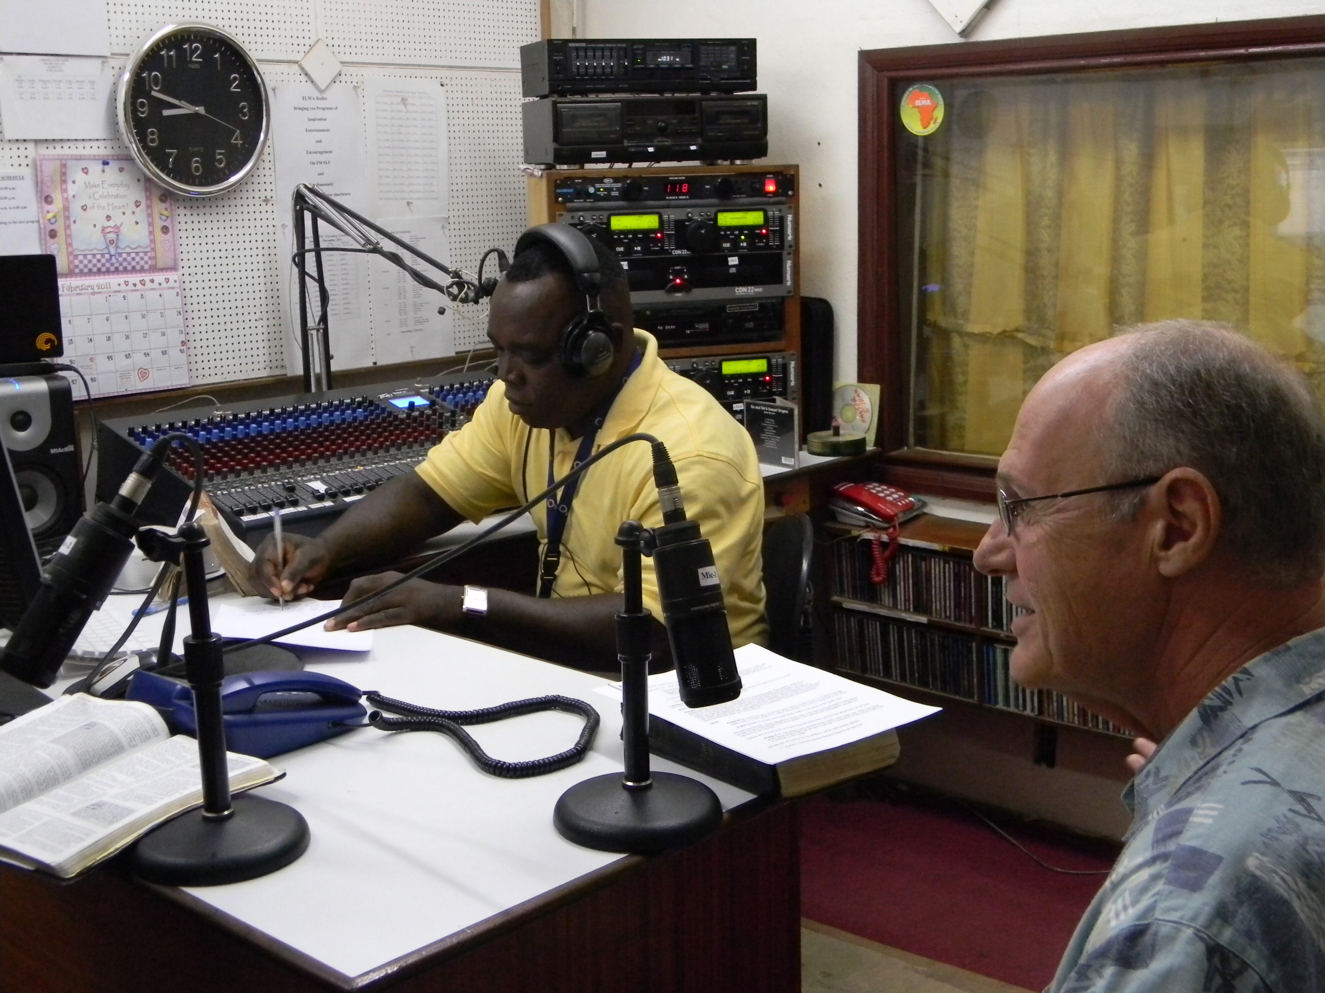
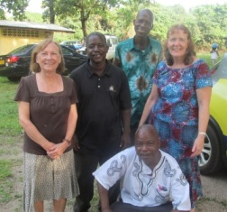
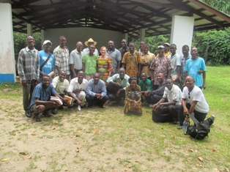
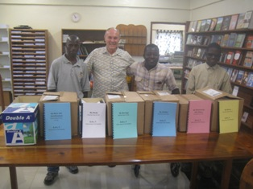
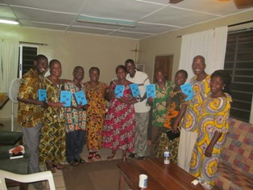
Our Ministries in Liberia:
BTCL Bible Training Center
Six years of daily devotions for ELWA Departments
Discipleship program for ELWA
Weekly Radio Bible Broadcast
Teacher and Principal Training
Books and Teacher’s Resource Room
Pastors trained to teach verse by verse
Visiting Professor of NT Studies, Monrovia Bible College and The Baptist Graduate Seminary

Slide 7
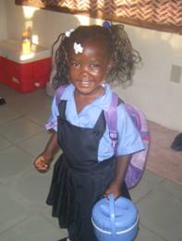
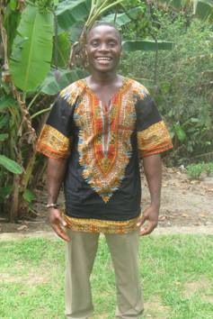
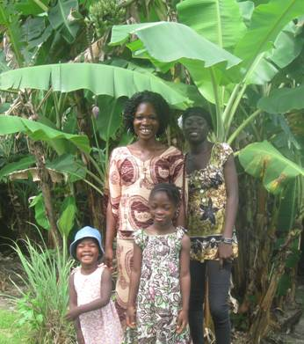
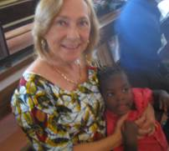
Our Liberian Family

Slide 8
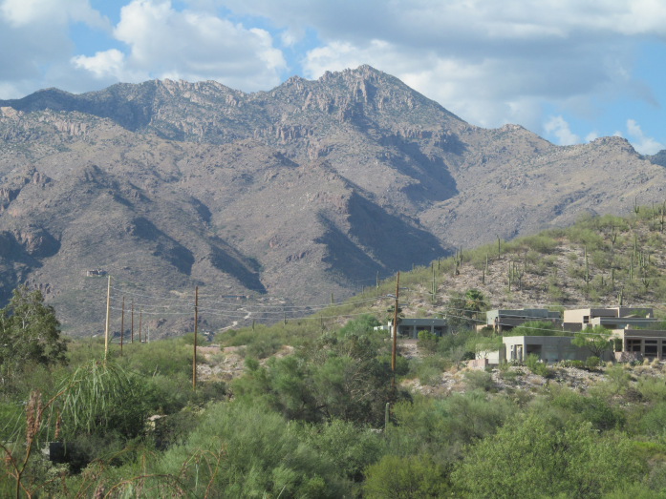
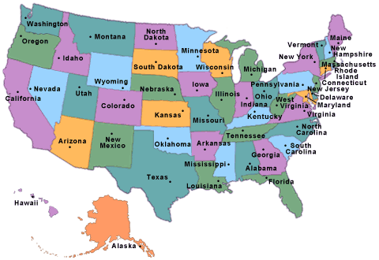
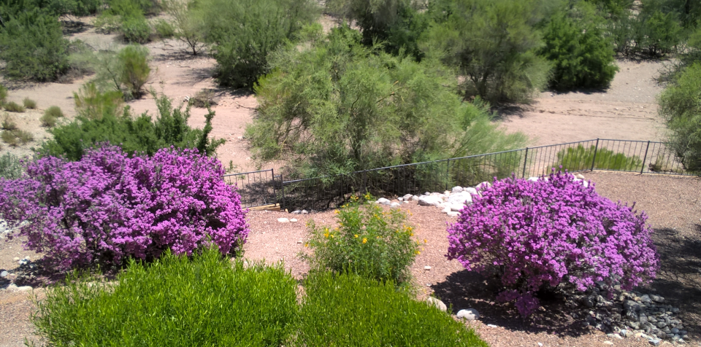
We left Liberia in June of 2015 and yet God has not taken us away from the mission. We now reside in Tucson, Arizona, USA but we have now dedicated ourselves to Project 85

Slide 9

To Train and Equip the 85% of the Pastors and Church Leaders in the World who have not had the opportunity to receive any Biblical, Pastoral, or Theological preparation
2016: Nigeria, Liberia, Cuba, and Uganda (twice)
2017: Cuba, Nigeria, Kenya, Zambia, and Rwanda-Uganda
2018: Ghana, Liberia, Nigeria, Kenya, Zambia, Rwanda-Uganda
2019: Nigeria, Zambia, Cuba, Liberia, Uganda

Slide 11
The Theology of Worship
Ambassador International University
April 2019
Instructor: Daniel W. Hill, Ph.D.

Slide 12
Exodus 33:15-16
Then he said to Him, If Your presence does not go with us, do not lead us up from here. For how then can it be known that I have found favor in Your sight, I and Your people? Is it not by Your going with us, so that we, I and Your people, may be distinguished from all the other people who are upon the face of the earth?
There is no presence like God’s presence
There is no absence like the absence of God’s presence
The presence of God is what distinguishes us from ALL other people on earth.
Presence – Personal -- Relationship

Slide 13
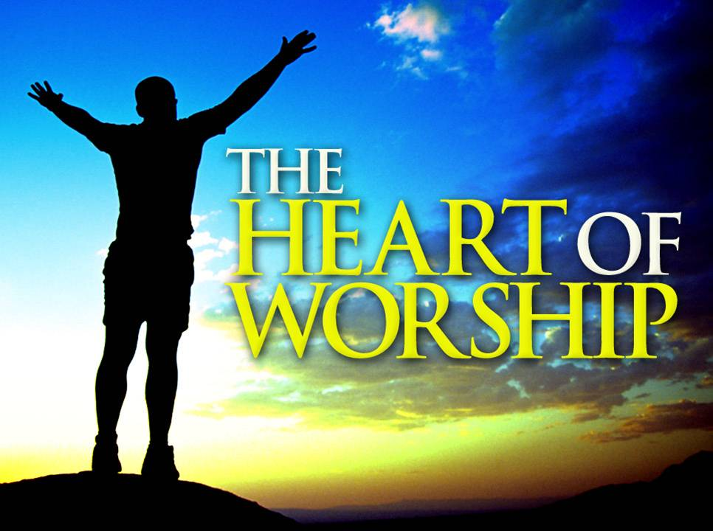
What Is Worship?
Worship in its simplest meaning is a meeting with God.
Worship is the event of interacting with God either in an individual or corporate basis.
Worship is the response of an adoring heart to the magnificence of God.
It is man’s loving response in personal faith to God’s personal revelation of Himself in Jesus Christ.
Genuine worship is always transformational in terms of God transforming the worshiper as we cannot transform ourselves.

Slide 14
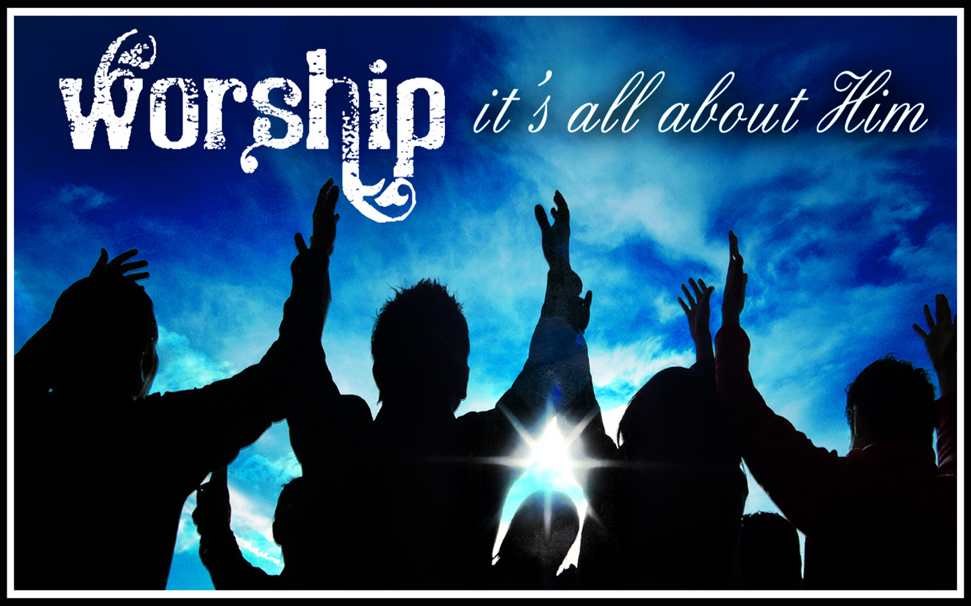
Meaning of the Word Worship:
Anglo-Saxon word weorthscipe (worth and ship) meaning one worthy of reverence and honor
Hebrew shachah, which means to bow down or prostrate oneself
NT Greek word προσ+κυνεω (proskuneo), meaning literally kiss the hand or to prostrate oneself before another in reverence
Liturgy is derived from the Greek λειτουργια leitourgia, translated ministry or service, means an action of the people

Slide 15
Webber: five new insights in thinking about worship (pp 7-f):
The primary work of the church is worship. Evangelism and other functions of ministry flow from the worship of the church.
Worship is a source for spiritual renewal. It is a celebration of what Christ has done (and is doing) in me.
Worship should become an active experience for the worshiper, a participatory event where we can respond to the Scriptures, prayer, fellowship and communion.
There should be a better balance between the Word of God and the Table of the Lord.
There is a need (or room for) for a return of the arts in worship. Use of the various arts (music, banners, liturgical dance, drama, color, etc.) can enhance and encourage worship.

Slide 16
Worship can be described with the following terms:
Mystery – We should approach worship with a deep sense of mystery, awe and wonder in light of preparing to encounter the one true living God
Celebration – In worship we are celebrating God for what He has done for us as well as who He is
Life – Every day with its experiences becomes an act of worship.. Worship is practicing the presence of God in every experience of life
Dialogue – God reveals Himself through the written Word, man responds to God through words and music and acts of celebration and dedication
Giving – The offering of our total selves to God is the result of worship
Eschatological Fulfilment – Our worship is a reminder of God’s coming redemption of His church (I Corinthians 11:26). Worship causes us to remember the hope that we have in Jesus and the joy that awaits us

Slide 17
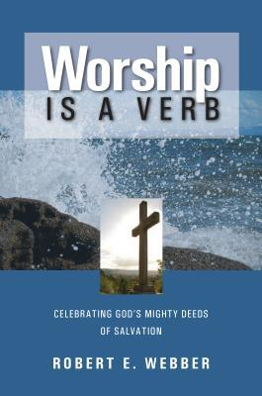
Webber’s eight principles of worship (p 15):
Worship Celebrates Christ
Worship Tells and Acts Out the Christ-Event
In Worship God Speaks and Acts
Worship Is an Act of Communication
In Worship We Respond to God and Each Other
Return Worship to the People
All Creation Joins in Worship
Worship as a Way of Life

Slide 18
Robert Webber: Principle 1 (p 21)
Worship Celebrates Christ
Worship should be a celebration of Christ’s life, death and resurrection for our salvation and for the salvation of the world. OT worship centered around the Exodus-event while NT worship centered around the Christ-event.

Slide 19
Three parallels between OT and NT:
God reveals Himself (OT - Exodus event; NT - Christ event)
God has come to redeem His people
The creation of a people in order to create a worshiping community as a sign of His redeeming work.

Slide 20
Worship in the Old Testament
The chief difference between pagan worship in the ancient world and the worship of God by the Israelites is the fact of God’s revelation of Himself to a particular people and His choice of them for his service. The worship of Israel differed from other civilizations in that:
Israel’s God was the only God
The God of Israel was a personal God
Israel had no image of God in its worship

Slide 21
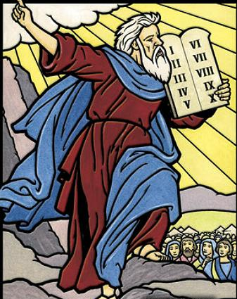
The ministry of MOSES and the EXODUS demonstrates what the nation of Israel was to be
But the PROPHETS reveal to us what they never became.

Slide 22
Principles about worship from Exodus and worship in the Old Testament:
God is SOVEREIGN over the affairs of His creation
God DELIVERED His people so that they might worship Him
Central to Exodus and the OT is the concept of REDEMPTION
The story of the Exodus and the OT is a FORESHADOWING of the deliverance we have in Christ redeeming and delivering us from the power of sin and death.
The RESPONSE should be to WORSHIP God for WHO HE IS and WHAT HE HAS DONE on our behalf

Slide 23
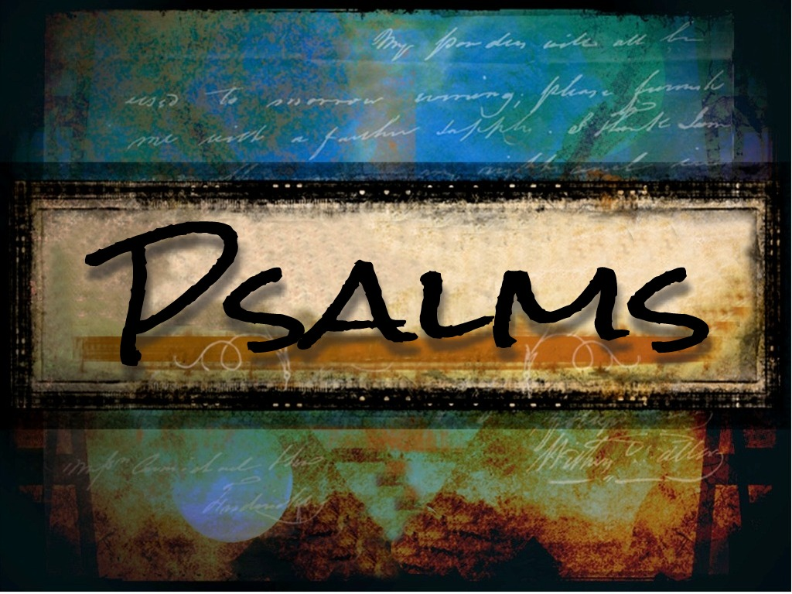
The Book of Psalms Israel’s Manual for Worship
THE PSALMS GIVE VOICE TO OUR PRAYERS AND OUR PRAISE

Slide 24
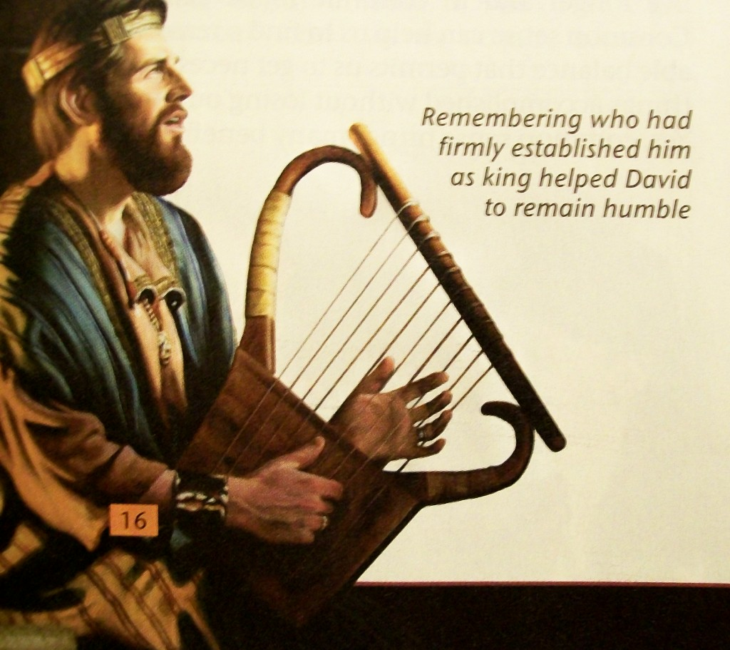
Writers of the Psalms:
73 were written by King David
12 by the song master Asaph who was appointed by David
12 by the Levitical family of the sons of Korah working under David
2 by King Solomon
1 each by the music masters Heman (Psa 88) and Ethan (Psa 89) who were probably appointed by David and Solomon
Psalm 90 was written by Moses

Slide 25
Different kinds of Psalms
Messianic Psalms – Prophetic looking ahead to Jesus (Ps. 2, 16:9-10, 22:1, 6-8, 16-18, 69:19-21
Royal Psalms refer to Israel’s king or Israel’s Messiah (Ps. 20)
Imprecatory Psalms invoke judgement or curses on one’s enemies (Ps. 58, 79:6, 12; 109)
Pilgrim psalms or Songs of Ascent, for pilgrimages going up to Jerusalem for three annual festivals (Ps. 42:1-4, 122)
Psalms of Praise, also called hymns, portray an offering of direct adoration to God (Ps. 33:1-3, 66, 95, 100)
Psalms of Thanksgiving usually reflect gratitude for a personal (Ps. 30) or communal (Ps. 65) deliverance or provision from God.
Psalms of Lament express the personal (Ps.3, 4;1) or communal (Ps. 44) crying out to God in difficult circumstances.

Slide 26
Hebrew poetry: parallelism
Psalm 103:10 is a good example of this.
He does not treat us as our sins deserve
or repay us according to our iniquities.
Psalm 145:18 is another example:
The LORD is near to all who call on him,
to all who call on him in truth.

Slide 27
TYPES OF HEBREW PARALLELISM:
Synonymous Parallel: Two lines that have almost the same meaning. Psalm 3:1, 7:17, 22:18
Synthetic Parallel: The building or increasing of an idea. Takes a line then in the second line furthers the idea or thought. Psalm 95:3
Antithetical Parallel: The second line is an opposite thought or a contrast to the first line. Psalm 1:6
Emblematic Parallel: Uses an image or illustration. Psalm 42:1, 23:1
Climactic Parallel: Repetition of a portion of a line. Psalm 29:1
Formal Parallel: Two lines joined by meter. Psalm 2:6
Alphabetical Parallel: Psalms Divided by the Hebrew Alphabet. Psalm 9, 10, 25, 34, 111, 112, 119, 145

Slide 28
Actions of worship in the Psalms:
The spoken voice
Speaking – Ps. 26:7, 34:1, 35:28 109:30, 111:1, 145:2
Shouting – Ps. 27:6, 33:3, 47:1, 47:5, 66:1, 71:23, 81:1, 98:4, 118:15
Singing - Ps. 5:11, 7:17, 9:2, 13:6, 21:13, 30:4, 33:1 & 3, 47:6-7 to name a few!
Our posture
Bowing – Ps. 5:7, 22:27, 95:6 (Parallelism or are they different?), 138:2
Kneeling – Ps. 95:6, 66:4, 138:2

Slide 29
Lying prostrate – No examples in Psalms but there are examples in other parts of Scripture: Numbers 24:4 & 16, Deuteronomy 9:18 & 25, I Kings 18:39, Rev. 4:10, 5:8 & 14
Standing – Ps. 119:120
Dancing – Ps. 30:11, 149:3, 150:4
Our Hands
Playing Instruments – Ps. 33:2-3, 68:25, 81:2, 150:3-5
Clapping – Ps. 47:1, 98:8
Lifting Hands – Ps. 28:2, 63:4

Slide 30
The Psalms summarized: Five key words:
Praise: The Psalmist worships, extols, and with heart-filled gratitude, thanks the sovereign God of Israel for His Person, His Word, and His mighty works in creation and redemption.
Prophecy: The Psalmist often writes of the coming Messiah, foretelling His zeal, suffering, death, resurrection, ascension, high priestly work, and coming millennial reign.
Pain: The Psalmist describes in graphic fashion his personal doubts, fears, pain and problems.
Petition: The Psalmist offers up requests, crying out for relief, forgiveness, reassurance, direction, protection and strength.
Poetry: The Psalmist pens his words in poetic fashion meant to be sung

Slide 31
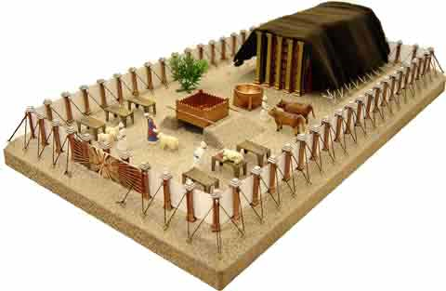
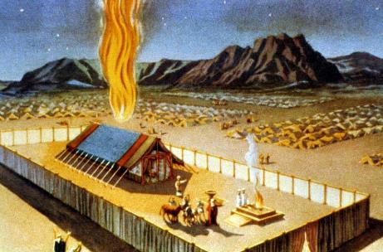
The Tabernacle: 1440 to 960 BC

Slide 32
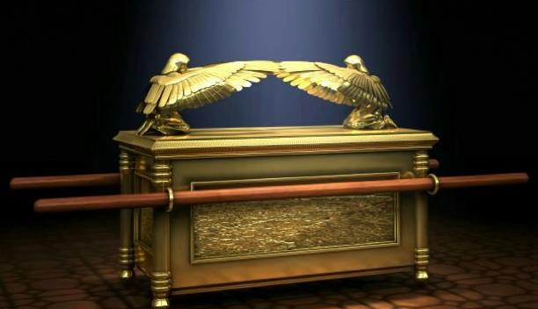
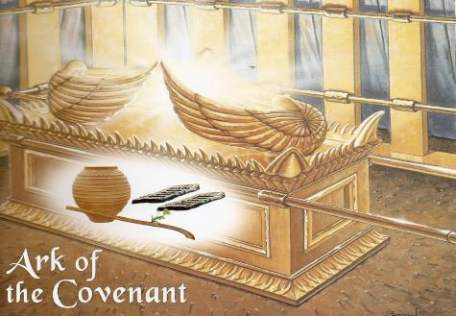
The Ark of the Covenant

Slide 33
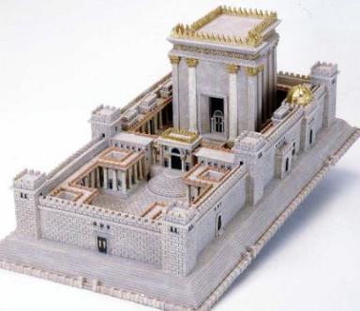
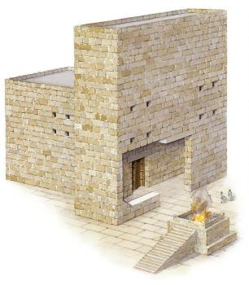
The First Temple – Designed by David and Built by Solomon (960 – 586 BC)
The Second Temple – Post Exilic, built by Zerubbabel,
516 BC – 20 BC

Slide 34
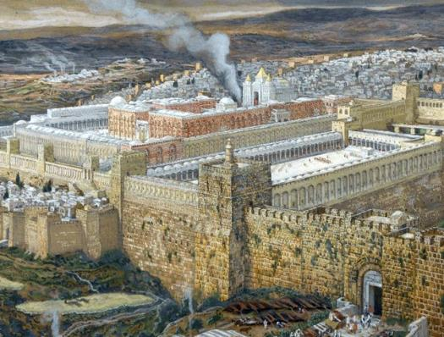
The Second Temple – Phase Two: Herod’s Temple, 20 BC to 70 AD
Considered one of the Great Building of the Ancient World
This was the Temple of Jesus’ Earthly Ministry

Slide 35
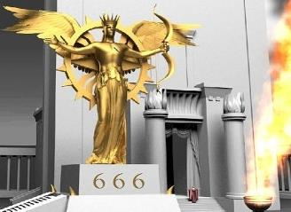
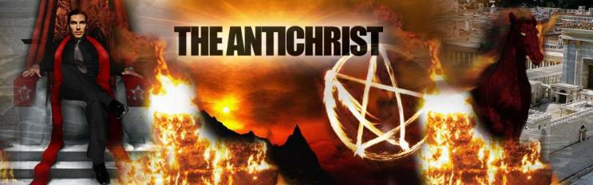
The Third Temple: The False Temple of the Antichrist during the Tribulation. The Abomination of Desolation set up at the middle of the Tribulation

Slide 36
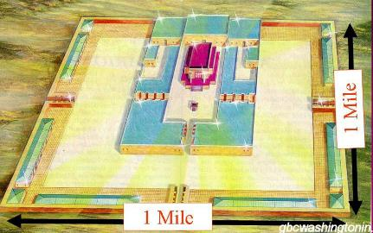
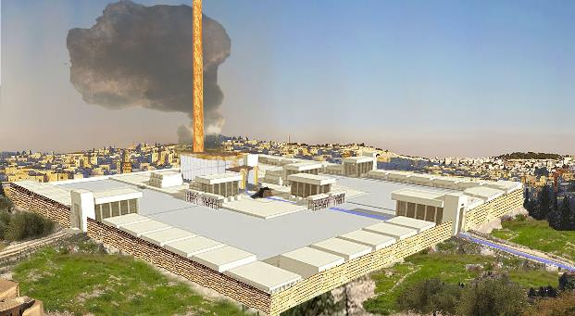
Millennial Temple, Built by the Lord Jesus Christ
Jesus will reign over Earth from this Temple

Slide 37
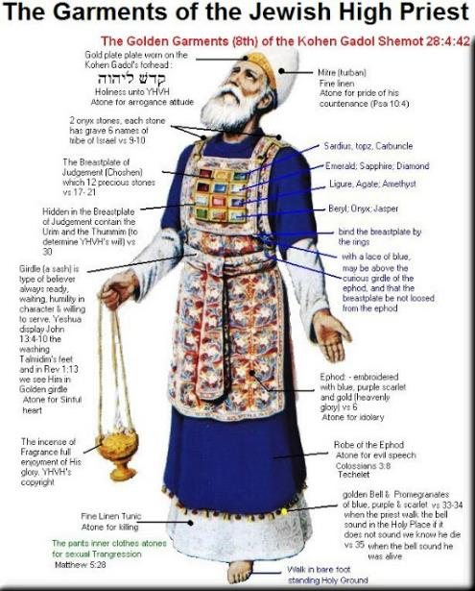
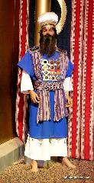
The High Priests
Descendants of Aaron
Chosen each year by God
Could only marry women who were in the priestly line

Slide 38
Levitical Sacrifices (All Look to the Person and Work of the Messiah):
Sin Offering: Celebrated Future Results of Cross
Guilt Offering: Sin Against Others (20% penalty)
Burnt Offering: Total Dependence on the Lord
Peace Offering: Thanksgiving at the Temple, a Family Feast
Grain Offering: Gratitude
Drink Offering: Sign of God’s Victory and His Joy in the Results of the Cross
Trespass Offering: Recognized God’s Acceptance of the Payment of Jesus’ Death at the Cross
First Fruits Offering: Faith Offering

Slide 39
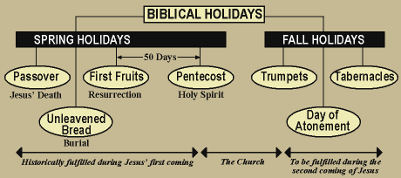
Seven Jewish Feast:
1. Passover 5. Trumpets
2. Unleavened Bread 6. First Fruits
3. Pentecost 7. Atonement
4. Tabernacles

Slide 40
Additional Jewish Feasts and Holy Days:
Shevat: (January 31) New Year for nature
Ta’anit Esther: (February 28) Esther became Queen
Purim: (March 2) Deliverance of Jewish people from Haman
Lag B’Omer: (March 31 – May 19) Birth of Jewish Mysticism
Shavuot: (May 19-21) Giving of the Torah to Moses at Sinai
The Three Weeks: Fast of Tammuz (July 1) and Fast of Tish B’Av (July 21) Mourning over the destruction of the Temple in 70 AD
The 15th of Av: (July 27) One of the great festivals
Rosh Hashanah: (August 12-September 12) Jewish New year
Chanukah: (December 12-20) Rededication of the Temple after the victories of the Maccabees

Slide 41
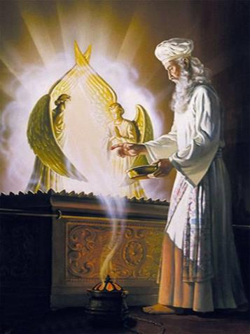
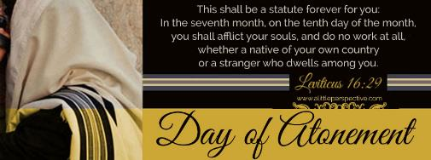
Day of Atonement
Falls between September 14 to October 14
Sacrifice and Offering to atone for the sins of the nation
All sins were read out loud (613)
Two Goats:
Scapegoat went into the wilderness
Other was sacrificed

Slide 42
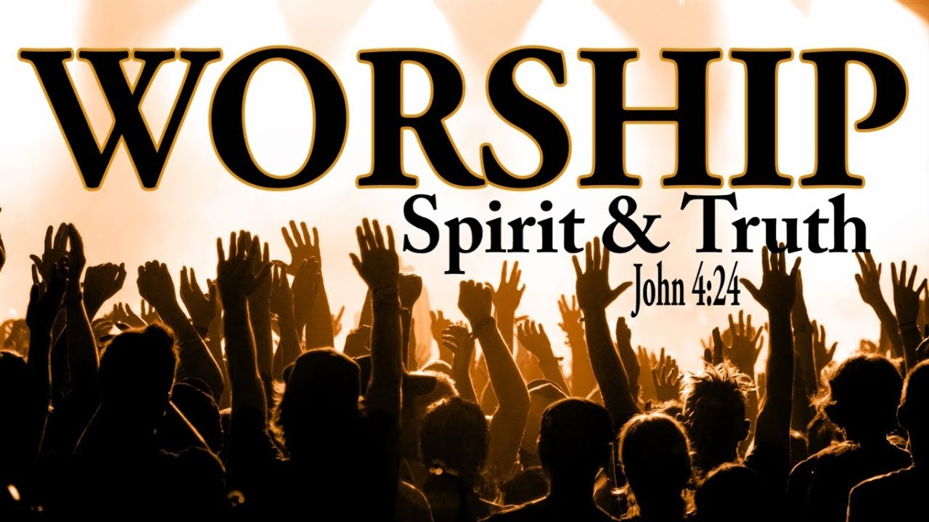
Worship in the New Testament
Early Christian worship was rooted in Jewish practices, as the first Christians were first of all Jews who had been faithful in their worship at the Temple and in their synagogues.
Early Christian worship was a combination of the practice, teaching and symbolism of the Temple and synagogue together with the special practices and teachings of Jesus.

Slide 43
The early church soon began to develop distinctive practices in worship:
The early Christians used writings of their own leaders. The epistles, the Gospels, which took precedence over the Law and the Prophets
Although the Psalms were used in worship, new hymns were added by Christian writers, such as those found in Paul’s letters
Baptism and the Lord’s Supper were distinctive of Christian worship
There was a spirit of zeal because of the resurrection which led to an unbounded enthusiasm with emphasis upon the risen Christ
Also differed from Jewish worship as to times and places. For the church, the first day of the week became the Christian day of worship in commemoration of the Resurrection. Although the early Christians at first worshiped in the Temple and the synagogues, they later met in house-churches

Slide 44
Robert Webber: Principle #2 (p 43)
Worship Tells and Acts Out the Christ-Event
Essentially, worship tells and acts out the life, death, resurrection and imminent return of Christ through the proclamation of the Word and the Table (communion)

Slide 45
The Four Parts of Worship:
Entrance – a preparation for worship; worshipers can prepare to worship and hear the Word . A time to focus on God.
The Word of God – two parts: the reading and preaching of the Word and the response to the Word.
The Table of the Lord – Symbolizes the Last Supper. A reminder of Christ’s sacrifice for us and His coming return. No Biblical command as to the frequency of communion, only as often . . .
The Dismissal – The church goes forth to be a witness (II Cor. 5:19-20). The intent is to go out to serve and to be a light in a dark world.
These four parts have a Biblical basis (Acts 2:42, I Cor. 11:20-22, 33-34)

Slide 46
Robert Webber: Principle #3 (p 65)
In Worship God Speaks and Acts
Our worship is too man-centered; we need to discover that it is God who is at work in worship. The primary importance in worship is not what I do, but what God is doing.

Slide 47
Discussion Question
How significant is the role of Scripture in the worship of your church? Do you have a personal experience when God communicated to you through the Scriptures in worship? How is the Lord’s Supper celebrated in your church? How often does your church have the Lord’s Supper and why?

Slide 48
Elements of New Testament Worship:
Music, an expression of praise (Eph. 5:18-21, Col. 3:16, I Cor. 14:15) various hymns can be found in the New Testament (Lk. 1:46, Lk. 2:29-32, Lk. 1:68 & Rev. 5:9, 12-13, 12:10-12 and 19:1-2, 6)
The reading of the Scriptures was a priority in early Christian worship. Jesus stood up in the synagogue to read the Scriptures (Lk. 4:16) and Paul makes numerous references to the reading of the Scriptures (Col. 4:16, I Thess. 5:27, I Tim. 4:13). Selections from the Old Testament were also used, especially from the Prophets and the Psalms.
Abundant evidence of prayers in early Christian worship. Many references to prayer can be found in Paul’s letters and the early church devoted themselves to prayer (Acts 2:42). Jesus gave the Model Prayer (Lord’s Prayer) as an example

Slide 49
Elements of New Testament Worship:
The people’s Amens are seen in many places in the NT.
Exposition of the Scriptures was an important part of early Christian worship (Acts 2:40, II Tim. 4:1-4).
Paul urged his fellow Christians to exhort and to reprove one another with authority in the Lord (I Thess. 3:2, II Thess. 3:12 & Titus 2:15).
Customary for Christians to give offerings. Paul exhorted the Christians at Corinth to share their material goods with their less fortunate brethren in Philippi (I Cor. 16:2; II Cor. 9:6-7, 10-13)

Slide 50
Elements of New Testament Worship (continued):
Doxologies: In the midst of his letters Paul continually breaks forth with doxologies unto God. Ephesians 1:3 and I Tim. 6:16.
Open confessions: Confession of faith in Jesus Christ . James urged his fellow Christians to confess their sins one to another and to pray for one another (James 5:16).
Christian worship included the ordinances of baptism and the Lord’s Supper. Baptism followed immediately upon one’s belief in Jesus Christ as Savior and Lord (Matt. 28:18-20; Acts 2:38-41; Gal. 3:27). Paul dealt at length with Lord’s Supper (I Cor. 11:20-34).
No particular order for worship. But there should be a logical and orderly sequence in worship.

Slide 51
New Testament defines worship differently than in the Old Testament:
A Change in Sacrifices
I Peter 2:5 and 9 you also, as living stones, are being built up as a spiritual house for a holy priesthood, to offer up spiritual sacrifices acceptable to God through Jesus Christ . . . But you are A CHOSEN RACE, A royal PRIESTHOOD, A HOLY NATION, A PEOPLE FOR God's OWN POSSESSION, so that you may proclaim the excellencies of Him who has called you out of darkness into His marvelous light.
A Change in Priestly Function
Hebrews 9:11-14 and 10:1-14

Slide 52
Christian / New Testament / Church Age Sacrifice:
Offer God Your Whole Self
Romans 12:1 I urge you therefore, brethren, by the mercies of God, to present your bodies a living and holy sacrifice . . .
Offer God Your Praise
Hebrews 13:15 Through Christ then, let us continually offer up a sacrifice of praise to God . . .
Offer God Your Material Resources
Hebrews 13:16 And let us not neglect . . . sharing, for with such sacrifices God is pleased.
Offer God Your Service to Others
Hebrews 13:16 And let us not neglect doing good . . . for with such sacrifices God is pleased.

Slide 53
Discussion Questions
What if we emphasize one form of worship to the exclusion of another?
Consider the different mixes of exclusions, the possible motives behind each mix, and the possible outcomes of each.
Prior to this study, which of these forms of worship did you understand the least about and why? Which do you think is your strongest/weakest? Why?

Slide 54
Robert Webber: Principle #4 (p 85)
Worship Is an Act of Communication
Worship communicates in two ways:
Verbally
Symbolically

Slide 55
Webber suggests that:
Personal preparation should occur before worship begins
Preparation and Dismissal are symbols which should be a part of worship
Body language can be a significant symbol used in worship (kneeling, bowing in prayer, greeting one another)
What do you think of these suggestions?

Slide 56
Robert Webber: Principle #5 (p 109)
In Worship We Respond to God and Each Other
Response is a necessary element in the communication that takes place in worship. We respond to God as the King and Ruler of all. Therefore, we must realize that our response should be that of awe, reverence and with a great sense of His majesty and omnipotence.

Slide 57
Questions: Describe the mood of your church – would you characterize the dominant mood as one of awe and reverence?
In what sense do you feel the Holy Spirit moving in your congregation?
Explain how you measure response – what effect does your perception have on your worship?
How does the order of your service encourage a response to what God has done, is doing and will do? How can the order of your service be changed to allow a strengthened response?

Slide 58
Theological Foundations for Worship
Worship is the experience of conscious communion with God and theology is the effort to describe the meaning of the experience. Thus, the two go hand in hand; we worship and experience the presence of God and our theological views are the way in which we try to understand and explain what we have experienced. It has been said that worship is revelation and response: God reveals Himself through the person of Jesus Christ and by faith man responds to God’s grace as he encounters God in worship.

Slide 59
God, Worthy of Worship
Christian worship is God-centered. God took the initiative in worship by creating man for fellowship with Him. As such, God is the source and sustainer of life. As man responds in worship, God allows him to experience new manifestations of His goodness and love.

Slide 60
Characteristics of God:
God is a personal God. A personal and spiritual Being, not an ideal, philosophy or metaphysical principle. He desires to have a personal relationship with men. He is a thinking, purposing, loving
God is a transcendent God. In all His attributes and ways, He is higher than man. My thoughts are not your thoughts, neither are your ways my ways, says the Lord (Isaiah 55:8). His holiness is a mystery to man and His magnificence is beyond description. The more that we experience God, the more we begin to humble ourselves before Him
God is an immanent God. God is constantly present. Paul said, He is not far from each one of us, for In him we live and move and have our being (Acts 17:27-28).
God is a trustworthy God. God is for us and can be trusted. By His grace He has saved (Romans 8:30-31) and nothing can separate us from His love (Romans 8:37-39).

Slide 61
Jesus Christ, Object of Faith (John 6)
Manifestation – God took on flesh and made Himself manifest to us in the person of Jesus Christ. Jesus declared Himself to be God in the flesh (John 10:30, 14:9).
Identification – Jesus identified with man in every area of man’s life. He was born as a man (Phil. 2:7) and lived as a man in the flesh. In the real humanity of Christ God came the whole way to man.
Redemption – Christ’s death brought the atonement that man needed to be reconciled with God. In the cross man sees God express His concern for mankind through the act of suffering love.
Living lordship – Jesus gave Himself for the church by His death, but He also gives Himself to the church in worship. (Phil 2:9-11) With the resurrection, Christ became the eternal answer to the power of sin and death. He is Lord of all.

Slide 62
Holy Spirit, the Dynamic of Worship
Every spiritual achievement is the work of the Holy Spirit. He is God at work in the church.
God’s personal Presence – God is present in man’s worship in His Spirit. Paul said that the Spirit is the mark of every Christian (Rom. 8:9) and the sign of God’s ownership (Eph. 1:13-14; II Cor. 1:22). To quench the Spirit of God is to refuse the power of God in worship.
God’s transforming power – Man’s salvation is made possible by the power of the Holy Spirit. The work of the Holy Spirit is seen in making man aware of his sin (John 16:8) and to make Christ known and make His truth clear to men (John 16:14-15). Through the Spirit’s power it is possible for man to live the life in Christ (Gal. 2:20).
Source of life in the church – It is the Holy Spirit’s function to inspire and guide the church in its worship and work. The Spirit is the “power source” of the church. Only as we walk and live by the Spirit can we bear the fruit of the Spirit (Gal. 5:22-25).

Slide 63
The Bible, the Eternal Word Through Words
The Bible is the life book of the church.
The heart of God is revealed through the Word of God.
A record of divine history
A witness to Jesus Christ
A record of human experience
The Word of the Spirit: Inspiration, Interpretation, Illumination

Slide 64
The Church, the People of God
The church is part of the entire body of Christ and exists not simply as an organization but more as a living organism indwelt and led by the Spirit
A redemptive fellowship and unique fellowship of people redeemed by God. Worship renews the church and helps to open its doors to everyone
A living organism – The church at worship is not merely a reminder that Jesus once lived but also a witness to the living presence of the risen Lord.
A worshiping congregation – A church can remain alive only as it continually comes to God in worship. The church is completely dependent upon the leading of the Holy Spirit; otherwise, it ceases to be that vital, vibrant witness God intended it to be.
A holy priesthood –Every member of Christ’s body is responsible to worship Christ by offering spiritual sacrifices. Every believer has the privilege and obligation to worship God for himself and to serve as a priest unto God for his fellowman.

Slide 65
Robert Webber: Principle #6 (p 129)
Return Worship to the People
Webber states that he has found an increasing desire among evangelicals to return worship to the people.
Congregational action needs these two conditions:
The congregation must understand what they are doing and
They must intend to make the responses that are part of worship.

Slide 66
We should keep two things in mind:
That everything should be done to build up the body of believers
I Corinthians 14:26 When you assemble, each one has a psalm, has a teaching, has a revelation, has a tongue, has an interpretation. Let all things be done for edification.
Everything should be done in a proper (fitting, decently) and orderly manner
I Corinthians 14:40 But all things must be done properly and in an orderly manner.

Slide 67
Structure or Process of the Worship Service:
The Entrance (preparation) begins the worship service and brings the body of believers together to focus on who God is, who we are and why we have gathered; to establish the mood for worship.
The purpose of the reading of the Word is to let God speak. The reading and preaching of God’s Word allows the believer to hear what God has to say.
Prayer as a way to respond to the Word, to pray and intercede on behalf of others.
The Communion Table reminds the believers of Jesus’ sacrifice on our behalf and His resurrection and victory over death.
The Dismissal sends believers out with the commission to share the love of Jesus with those who are unbelievers. We are dismissed, not just as an end to the worship service but to go serve.

Slide 68
Robert Webber: Principle #7 (Part 1, p 157)
All Creation Joins in Worship
Webber questions the idea of using the morning worship service to focus entirely on Mother’s Day, Memorial Day or other secular holidays or events. Instead, he says that the morning worship is a time to celebrate Christ’s living, dying and rising again for our salvation.
What do you think?

Slide 69

A Psychology of Worship

Slide 70
Man Responses in Worship with:
With his senses (sight, hearing, smell, taste and touch); the music of worship, the sanctuary and its décor, the Lord’s Supper. How are senses involved in your worship service?
With his mind. God created man to be a thinking being. Worship that isn’t understood isn’t genuine worship. Have you ever been in a worship experience where you couldn’t understand what was going on?
With his emotions; man was created to respond in worship with his emotions. There should be a balance between unbridled emotionalism and cold objectivity in worship. Have you experienced worship in either of these extremes?
With his will; man encounters God in worship and is challenged to accept or reject God’s will. To follow Jesus is to commit oneself to His leading (I Corinthians 6:19-20). What does commitment mean?

Slide 71
The desire to worship lies in:
A sense of finiteness seeking the infinite.
A sense of mystery seeking understanding.
A sense of insecurity seeking refuge.
A sense of loneliness seeking companionship with God.
A sense of human nature seeking mutual fellowship with others.
A sense of remorse seeking forgiveness and absolution.
A sense of anxiety seeking peace.
A sense of meaninglessness seeking purpose and fulfillment.
A sense of brokenness seeking healing.
A sense of grief seeking comfort.

Slide 72
Attitudes conducive to worship:
Adoration – reverence and awe of the splendor, mystery of God.
Gratitude – an attitude of thankfulness for all of God’s mercy and grace. Thanking God for His blessings as the sources of blessing.
Repentance – an attitude of humility and confession. Repentance involves dying to self and confessing (agreeing with God) our sin to Him. Confession also includes acceptance of God’s forgiveness.
Dependence – an attitude of acknowledging that God is the source of everything and that man is dependent upon Him for his every need.
Submission – an attitude of surrender. Every significant worship experience calls for submission and surrender to the will of God.
Commitment – an attitude of active, willful dedication to God. This act of the will calls the believer to action in doing the will of God

Slide 73
Robert Webber: Principle #7 (Part 2, p 179)
All Creation Joins in Worship
The use of art forms in worship and the extent of such use is a subject that has been debated for centuries.
The issue comes down to a difference of opinion

Slide 74
A Historical Difference of Opinion:
Orthodox – use of senses in the OT and Jesus as God incarnate allow use of various forms of art, music, etc.
Protestant – the 2nd Commandment forbids any images as a part of worship (although use of candles, vestments, musical instruments, stained glass windows, etc. is allowed)
Calvin and Luther: Luther believed whatever is not explicitly rejected by Scripture may be used in worship; Calvin held the belief that only what is explicitly taught in the NT is allowed in worship.
Webber states that we cannot hope to solve this age-old controversy here (and he is right!)

Slide 75
Robert Webber: Principle #8 (p 203)
Worship as a Way of Life
Worship becomes a part of all of life as we learn to see worship as a way of life, not just a part of our lives to be acted upon once a week.

Slide 76
Worship is the primary activity of the church
As worship becomes a way of life, we begin to see that there is a connection between public worship, private prayer and all of life.
Making the church year and its special days a part of family life helps to integrate worship in the church with worship in the home.
In relation to our daily work, worship can encourage believers to live out their Christian values in the workplace, giving a witness to their faith among nonbelievers.
Believers can accomplish their work without compromising truth and fulfill the command of doing all things for the glory of God (I Cor. 10:31)
Our worship should lead us into the world to serve.
Evangelism is a result of worship as we invite others to hear about Jesus Christ.

Slide 77


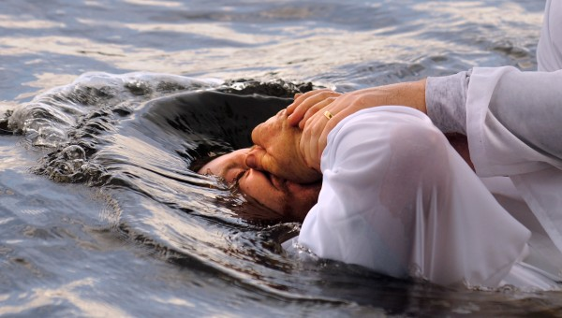

The Bible tells us of Seven Baptism:
Four REAL
three RITUAL

Slide 78
REAL BAPTISMS (4): A person or persons identified with something real, DRY:
MOSES', I Corinthians 10:2
FIRE, Luke 3:16
CROSS or CUP, Luke 12:50 and Matthew 26:39, Matthew 20:22, John 18:11
HOLY SPIRIT BAPTISM, Acts 1:5, Romans 6:3-4, I Corinthians 12:13, Galatians 3:26-28, Ephesians 4:5

Slide 79
RITUAL BAPTISMS (3): Water is used which represents something else. Immersion was the mode:
BAPTISM OF JESUS BY JOHN, unique and one of a kind.
JOHN'S BAPTISM, a new thing in Israel. Normally only for Gentile converts
BELIEVER'S OR CHRISTIAN BAPTISM (continued next slide)

Slide 80
Believer’s or Christian Baptism by Immersion:
The water represents the body of Christ
Identification with Christ and His Death and Resurrection
Illustrates retroactive positional truth in that the believer in going under the water is identified with Christ in his death and coming out of the water is identified with Christ in his resurrection
Illustrates that which Holy Spirit Baptism does in actuality
Occurs after personal salvation but it is NOT salvation
It is not following the Lord in His unique baptism
Has nothing to do with church membership
Was practiced by the post apostolic church as a means of teaching Baptism of the Holy Spirit and our identification with Christ

Slide 81
Romans 6:1-4 What shall we say then? Are we to continue in sin that grace may abound? By no means! How can we who died to sin still live in it? Do you not know that all of us who have been baptized into Christ Jesus were baptized into his death? We were buried therefore with him by baptism into death, in order that, just as Christ was raised from the dead by the glory of the Father, we too might walk in newness of life.
The Greek NT word for baptism is BAPTIZO
βαπτιζω
And means, to identify and to immerse

Slide 82
What about Infant Baptism?
Unknown in the New Testament
Irenaeus, about 180 AD referred to: All through Christ who are born again to God, infants and children boys and youth and old men
This is the source used for infant Baptism but with all the writings before this there is no mention of infant baptism
The issue is dispensational: Paralleling infant baptism to the Jewish ceremonies of circumcision, proselyte baptism
If we rightly divide the Word of Truth we will leave Jewish ceremonies with the Age of Israel and look to the Epistle for our standard of practice and we find no mention of infant baptism.
Dedication of a Child (Christian parents with their responsibility to raise their child in a Christian environment and providing Christian God parents) is a good ritual but should not be viewed as a sacrament nor confused with baptism

Slide 83
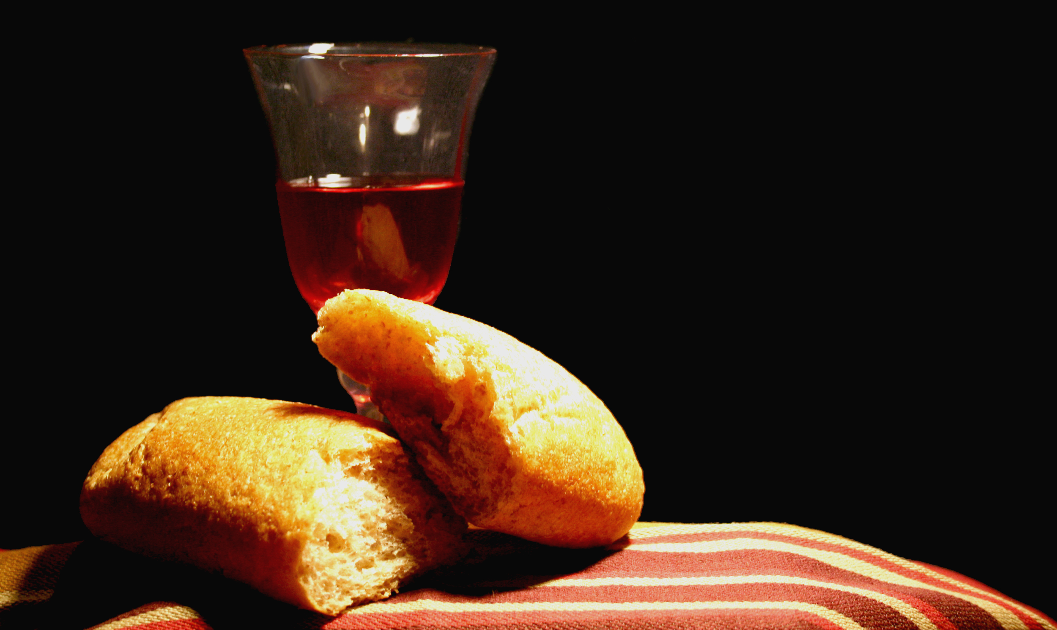
Communion, Lord’s Supper, Lord’s Table, Eucharist
Main Teaching Passage:
I Corinthians 11:23-34

Slide 84
Reasons we Celebrate the Lord’s Supper:
As a symbol of remembrance of Jesus’ suffering, death, and resurrection, Matthew 26:26-28, II Timothy 2:8
To celebrate our unity in Christ within the local church and with fellow believers, Ephesians 4:3, 4:13, and Colossians 3:14
To anticipate His return in victory (first Rapture and then Second Advent), 1 Corinthians 11:23-26

Slide 85
Insights About Worship, Henry T. Blackaby
To God worship is vital, to not have genuine worship is fatal.
Possible to thing we have true worshiped without having it
In Romans 12:1-2 we find the kind of worship God is looking for – Present our bodies as living and holy sacrifices t
In leading worship it is not how people are responding to us but how they are responding to God
Nothing is higher on God’s agenda than true worship.
Nothing is higher on Satan’s agenda than to deceive God’s people in worship, create substitutes for true worship
As we depend on God’s Word and the Holy Spirit (who is always in harmony with God’s Word) to lead us, our worship will be a genuine encounter with God.

Slide 86
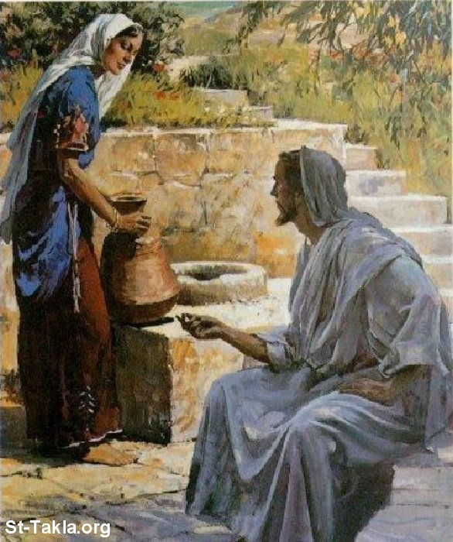
John 4
Jesus and the Woman at the Well

Slide 87
John 4:23-24
But an hour is coming, and now is, when the true worshipers will worship the Father in spirit and truth; for such people the Father seeks to be His worshipers. God is spirit, and those who worship Him must worship in spirit and truth.

Slide 88
Worshiping in spirit, five basic truths:
We will be born of the Spirit; our spirits will be alive to God.
We will recognize the importance of the Holy Spirit’s working in our lives and yield to His control because He God.
We will respond to the Holy Spirit’s conviction and correction, maintaining a repentant and contrite heart toward God.
Our focus will be on God; we must not allow the music, people or anything else to become the focus of our worship. God is both the subject and the object of worship. We must worship God with an undivided heart (Psalm 86:11).
Fulfilled doctrinally in Ephesian 5:18-19 Worship follows the Filling of the Holy Spirit.

Slide 89
To worship in truth: to worship with our minds AND our spirit
Worship is more than an emotional experience
Worship in truth: our worship will be based on God’s Word. We need to have a correct view of God for acceptable worship (I Timothy 1:17, Psalm 104:1)
Worship in truth means that preaching and teaching of God’s Word will be indispensable in our worship. The Bible occupies a central place in our worship (Nehemiah 8:2-3, 5-60)
To worship in truth also means that we as individual worshipers will study God’s Word (Psalm 119:11)
Doctrinally Fulfilled in Colossians 3:16. Worship follows the indwelling of the Word in the believer.

Slide 90
Consider this quote by Warren Wiersbe
I am not worshiping God because of what He will do for me, but because of what He is to me. When worship becomes pragmatic, it ceases to be worship. R. G. Letourneau used to say, If you give because it pays, it won’t pay. The principle applies to worship; if you worship because it pays, it won’t pay. Our motive must be to please God and glorify Him alone.

Slide 91
Obedience is central to worship
BUT WITHOUT FAITH first there is no obedience that honors God
Hebrews 11:6
Abraham demonstrated his love for God in his obedience because he trusted (faith) God and therefore, trusted His command (Genesis 12).
If we are not trusting God and eager to obey what God asks us to do, we are not ready to worship. When we worship God out of our love for Him, obedience naturally follows. Obedience is central to worship.

Slide 92
From Old Testament to New Testament
OT worship took place through the high priest, who was the only one allowed to enter the holy of holies once a year to offer a blood sacrifice on behalf of the Jewish nation.
In the NT, however, we no longer have to go through an earthly high priest or make blood sacrifices anymore (read Hebrews 9:11-12 & 14).
The attitude of heart that God looks for has not changed but only the method.

Slide 93
Worship and the New Birth (Read out loud John 9:35-38)
Though the man was physically healed, he was not yet a believer. The man’s response showed that he did not really know who Jesus was.
Revelation precedes salvation. Until Jesus reveals Himself to us and we see Him as our only hope of salvation from eternal death, we remain lost.
There is no redemption without an attitude of worship. The man responded by addressing Jesus as Lord and then he worshiped Him.
There is no salvation without repentance. The man had a worshiping heart which is also a repentant heart.

Slide 94
God’s Standard for Acceptable Worship
Why does God require a sacrifice? Sin had to be paid for; a sin offering needed to be made. God planned from the beginning to redeem His creation:
It began with a lamb for a man (Genesis 4:4); the blood of one lamb was sufficient for the sins of one man.
In Job 19:25 As for me, I know that my Redeemer lives, and at the last He will take His stand on the earth.
At the Passover in Egypt it became a lamb for a family (Exodus 12:3,5 and Exodus 12:23).
In Leviticus, God a further dimensions of the sin offering, a lamb for a nation (Leviticus 16:34)
Now the story of redemption reaches a climax with Jesus as the sin offering, a the Lamb for the sin of the world (John 1:29, John 3:16 and I Peter 1:19).

Slide 95
God’s Standard for Acceptable Worship continued
What kind of sacrifice does God want now?
A sacrifice that has been prepared (I Peter 2:1-3, Psalm 15)
A sacrifice that is Christ-centered and Christ-honoring (I Peter 2:4).
The corporate sacrifice of living stones that make up a household of faith (I Peter 2:5). In Him we are being built up into a spiritual house with Jesus as the chief cornerstone (I Peter 2:6-8).

Slide 96
God’s Standard for Acceptable Worship continued
At the heart of NT worship is the offering of ourselves completely to God (Romans 12:1-2)
The sacrifice God is looking for is a complete one, (read I Chron. 21:18-26; this passage defines giving).
The sacrifice we make will be a living one – a continual presenting of ourselves to God
The sacrifice we make will be a holy one (I John 1:9). Forgiveness and cleansing are the preparations for a holy sacrifice.
The sacrifice we make will be acceptable by God if we offer it as living and holy
The sacrifice we make will be a transforming one

Slide 97
Response in Worship – First response is Faith / Trust (Hebrews 11:6)
In Submission – Action is humility, Isaiah 57:15, Matthew 5:3, I Peter 5:5. Also, II Chronicles 7:14, Luke 18:9-14 reveals the heart attitude that God is looking for in our worship.
In Abdication – (Revelation 4:9-10) Yet Jesus gave up His rights to pay our debt of sin that we could never have paid. We have been bought at a price and need to have the mind of Christ (Philippians 2:6-8).
The Climax of Worship – Isaiah 6:1-8. The climax (result) of worship is service. The expression of a servant’s heart, of one who has humbled himself, surrendered his rights and is willing and ready to serve his Master at all costs. This is the life of a true worshiper.
Everything comes from worship (which is meaningless without faith) – the building of the Body of Christ, spiritual growth and training, missions, even evangelism.

Slide 98
What must we do to obey God in personal worship?
Each Christian must choose (by faith) to live a lifestyle of worship (Matthew 7:7-8 as a way of life).
A Christian must anticipate fresh encounters with God constantly, John 14:26, 16:13 Approaching the Scriptures in an attitude of worship; Prayer, expecting a full encounter with God in worship, seeking the enabling (filling) of the Holy Spirit (John 16:13-15)
A true worshiper must know the voice of God and know when He is speaking (through the Word, through other Christians).
A Christian must come to worship by faith with a heart and life committed to obey by faith / trusting Him. This is an act of the believer’s will.

Slide 99
What must we do to obey God in corporate worship?
We must choose (by faith) to be with God’s people wherever the body may gather (in a home, in a church, in the workplace).
God’s people must choose not to forsake meeting together (Hebrews 10:25). Each gathering holds infinite potential with God.
Each believer must be an active seeker after God when Christians meet in corporate worship. God does things with His people corporately that He does not do individually. Every believer must come expecting God to move as the church meets for worship.
Each worshiper must come with a commitment to obey God’s commands. Every worshiper must have an attitude of Yes, Lord! even before knowing God’s will or hearing His voice.

Slide 100
SELAH

